Slide 1
EXPLORING THE SEATTLE PUBLIC LIBRARY
FELICE FRANCARIO
SU DOGAN
SEYED ALI AMIR KHORASANI

Slide 2

INTRODUCTION
The Seattle Public Library (SPL) is the public library system serving the city of Seattle, Washington.
The system currently comprises 27 branches, most of which are named after the neighborhoods in which they are located.
Roughly one million cataloged physical items including Books, CDs, DVDs.
Extensive online resources are available to youth ages 13 to 21 throughout the United States

Slide 3
OUTLINE
Monthly Time series that we analysed:
Total Book checkouts
Unique Book Title checkouts
Checkouts per unique title (with different degrees of filtering)
Maximum Checkouts
Total Ebook and Audiobook checkouts
Best Selling New york times books in the last 20 years
*ANALYSED FOR 18 DIFFERENT FICTION AND NON FICTION GENRES

Slide 4
Exploring Trends by Genre
Divide the charts into two period from 2005 to 2014 from 2015 to 2023
Assessing the trends with two metrics 1. slop: computed using fitting a Linear model to the chart and using its coefficient
2. mean of monthly change rate in each period: Calculated as the difference between the final and initial values, divided by the months in the period

Slide 5
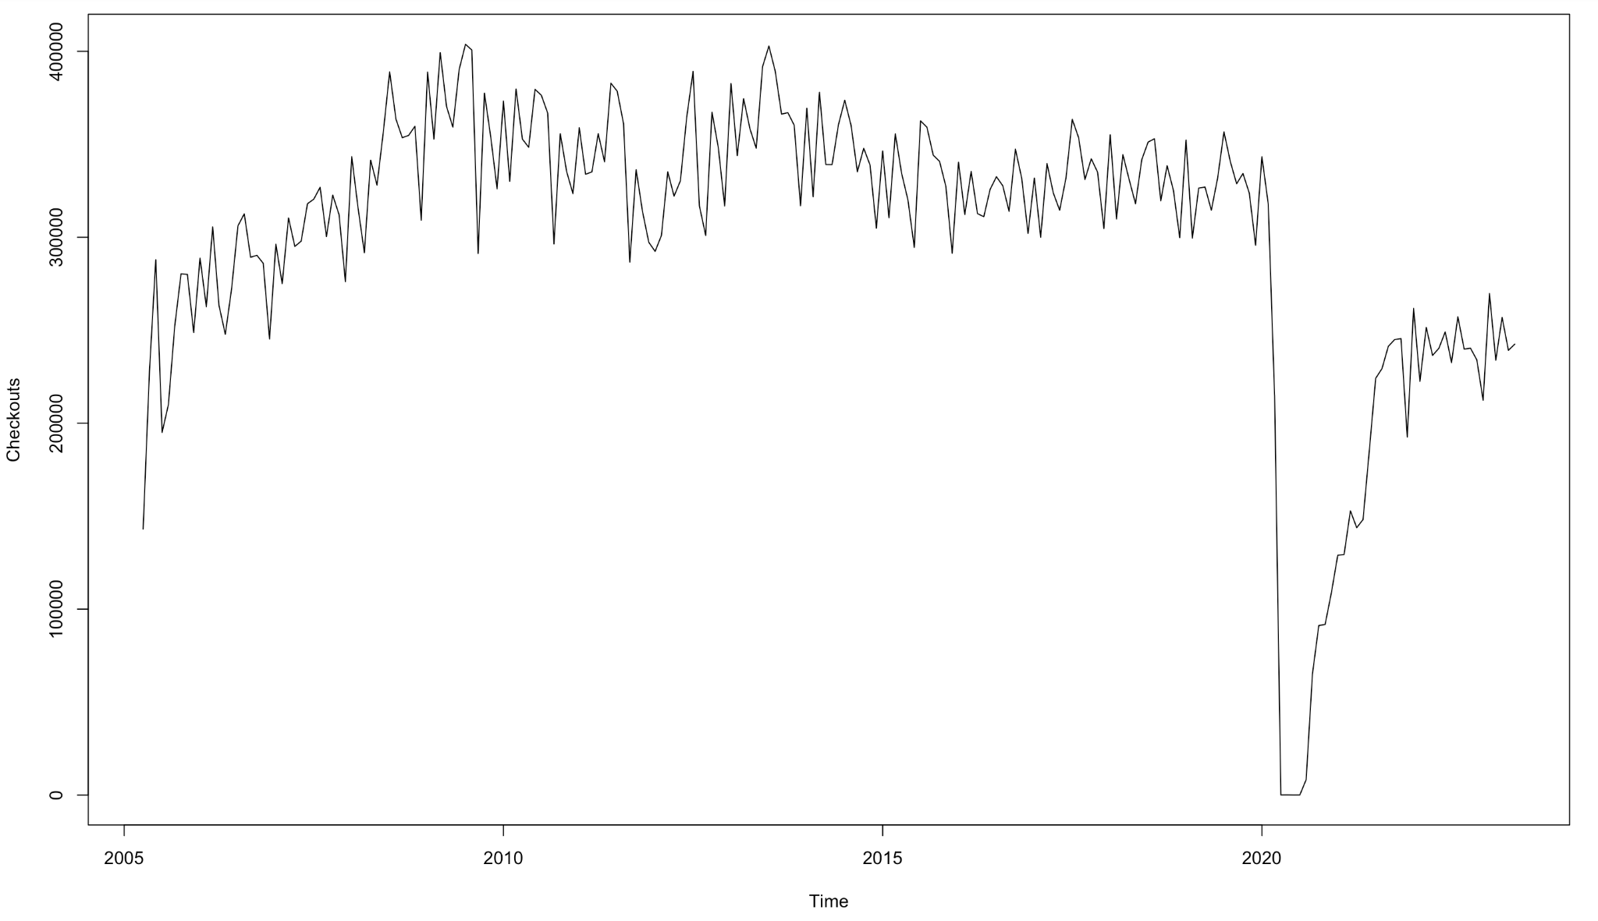
Total Books checkouts
Total Checkouts of all books data from
2005 to 2023

Slide 6
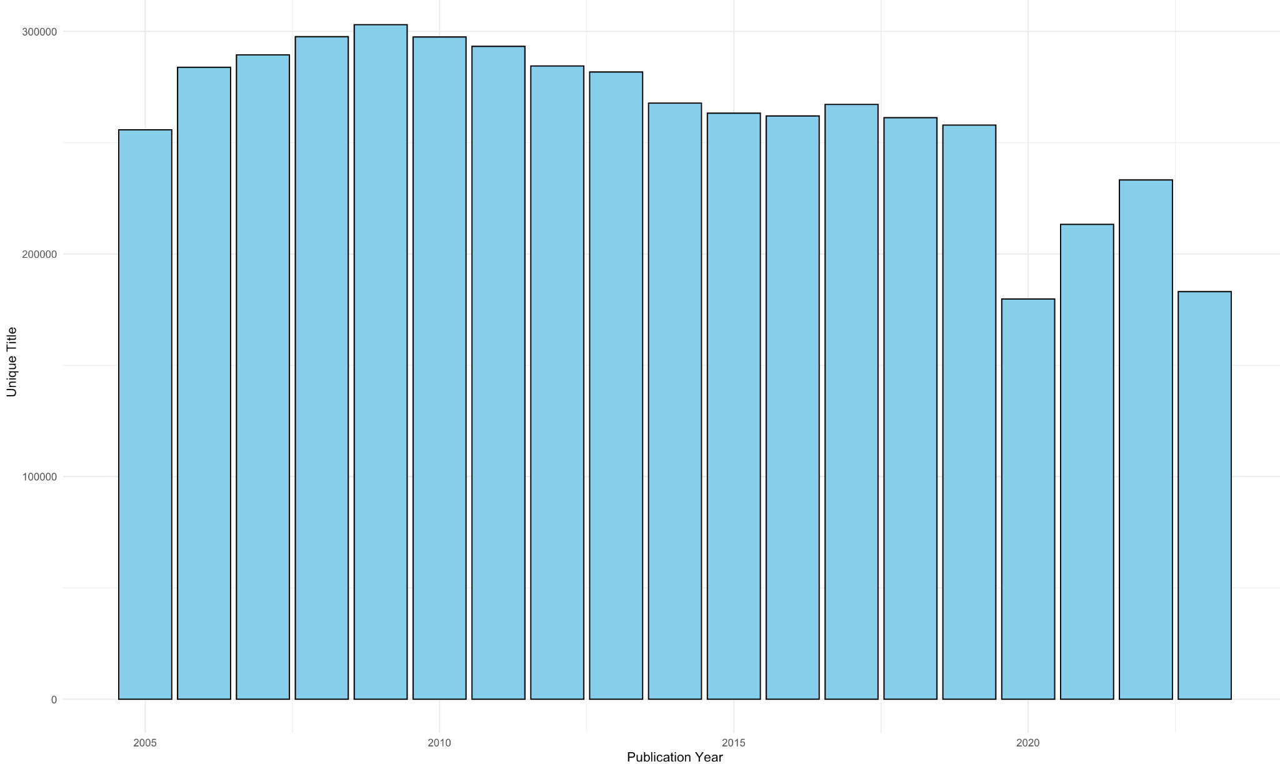
Unique Books title checkouts
Unique book title checkouts data from
2005 to 2023 by year

Slide 7
Genre Selection
selecting 18 genre to analyze across two categories
splitting into two groups
Fiction Genres: Mystery, Science Fiction, Romance, Fantasy, Historical Fiction, Adventure, Thriller, Humor, Psychological
Non Fiction Genres: History, Biography, Finance, Health, Business, Travel, Religion, Cooking, Autobiography

Slide 8
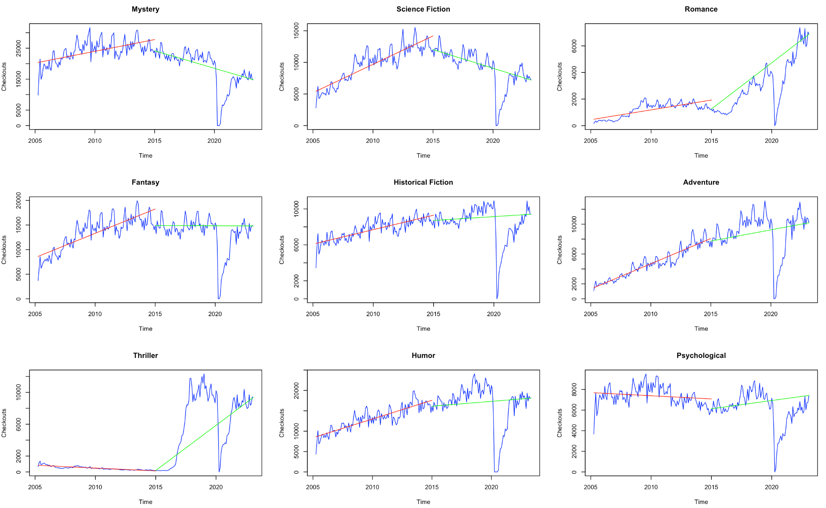
Fiction genres books checkouts
Mean monthly change rate
Genres\year period | 2005 - 2014 | 2015 - 2023
Mystery | 7.7 | -4.7
Sci-Fiction | 32.2 | -4.9
Romance | 91.4 | 55.3
Fantasy | 26.7 | -0.1
Historical fiction | 9.3 | 1.0
Adventure | 62.4 | 3.8
Thriller | -11.1 | 607.1
Humor | 21.2 | 1.4
Psychological | -1.6 | 2.6

Slide 9
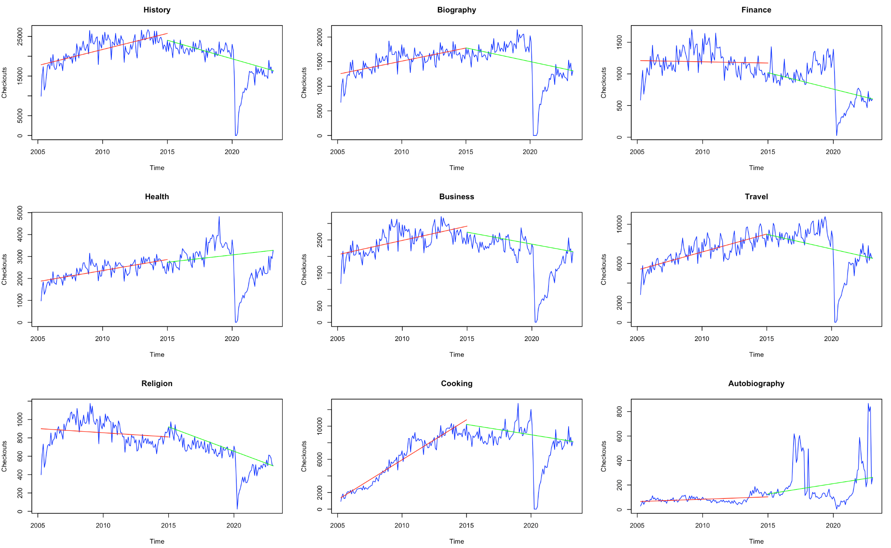
Non Fiction genres books checkouts
Mean monthly change rate
Genres\year period | 2005 - 2014 | 2015 - 2023
History | 8.2 | -3.9
Biography | 7.9 | -3.1
Finance | -0.7 | -5.1
Health | 10.3 | 2.4
Business | 7.4 | -2.6
Travel | 13 | -3.3
Religion | -2.3 | -5.8
cooking | 104 | -2.4
Autobiography | 13.9 | 13.3

Slide 10
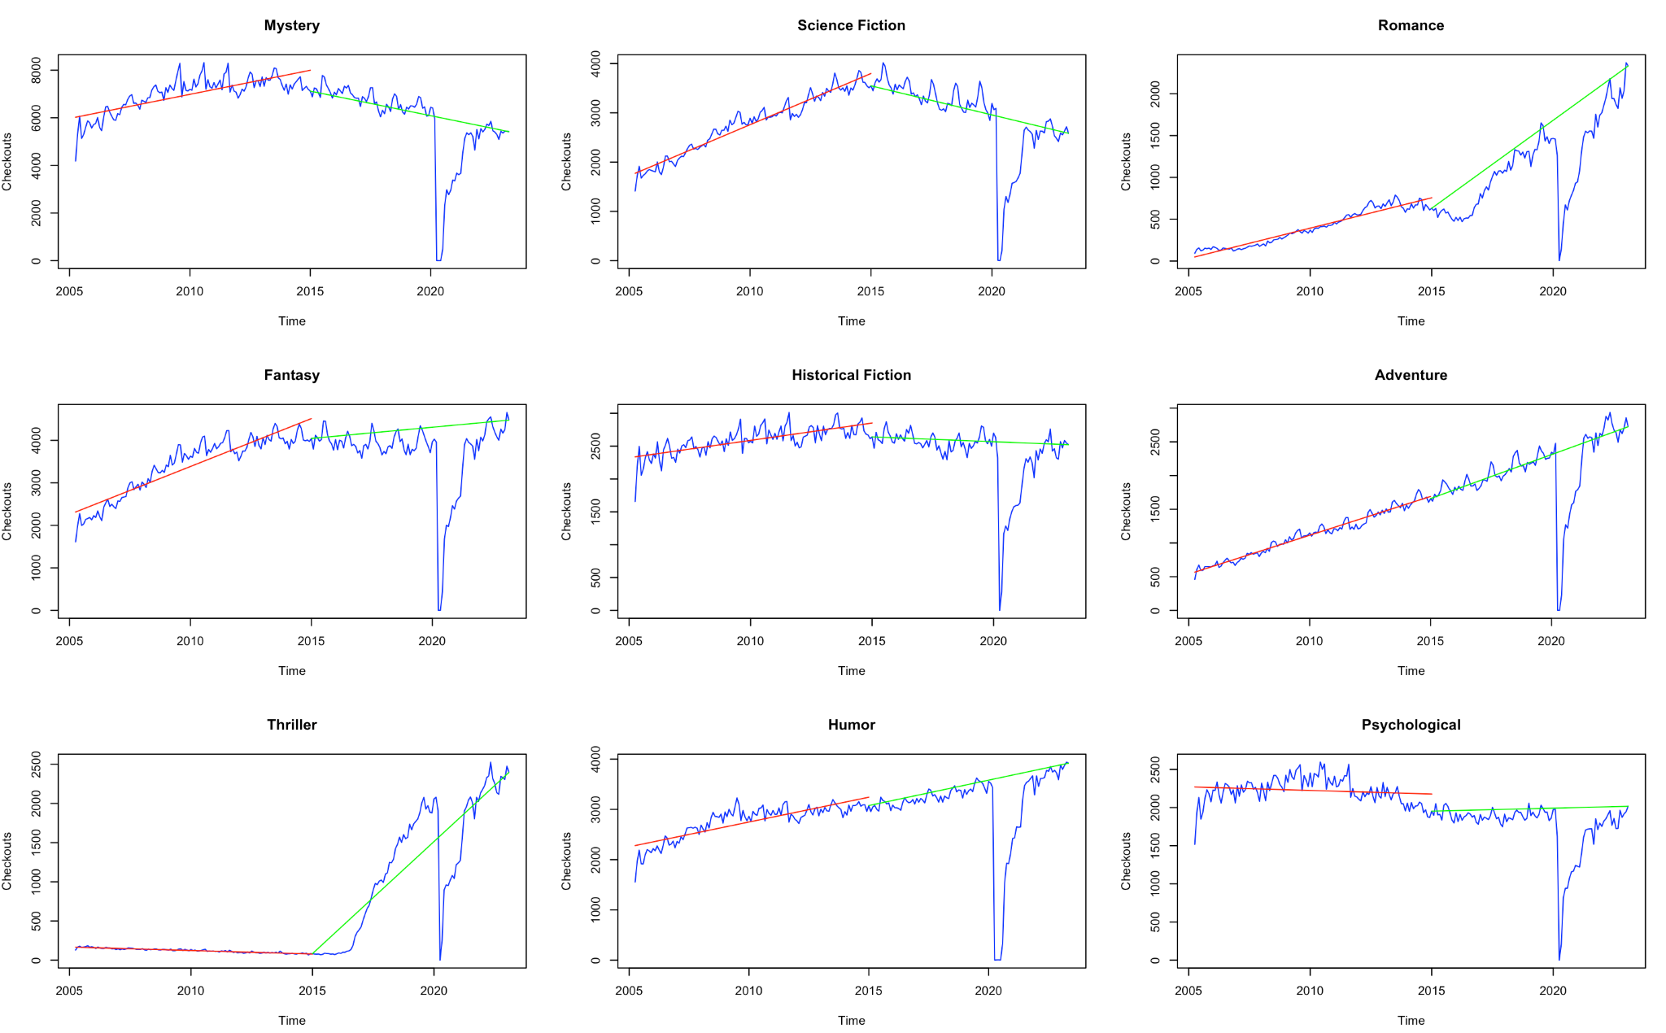
Fiction genres unique books checkouts
Mean monthly change rate
Genres\year period | 2005 - 2014 | 2015 - 2023
Mystery | 4.8 | -2.9
Sci-Fiction | 14.7 | -3.3
Romance | 78 | 33.3
Fantasy | 14 | 1.3
Historical fiction | 3.2 | -0.5
Adventure | 25.1 | 7.8
Thriller | -6.9 | 344.7
Humor | 6.3 | 3.2
Psychological | -0.6 | 0.4

Slide 11
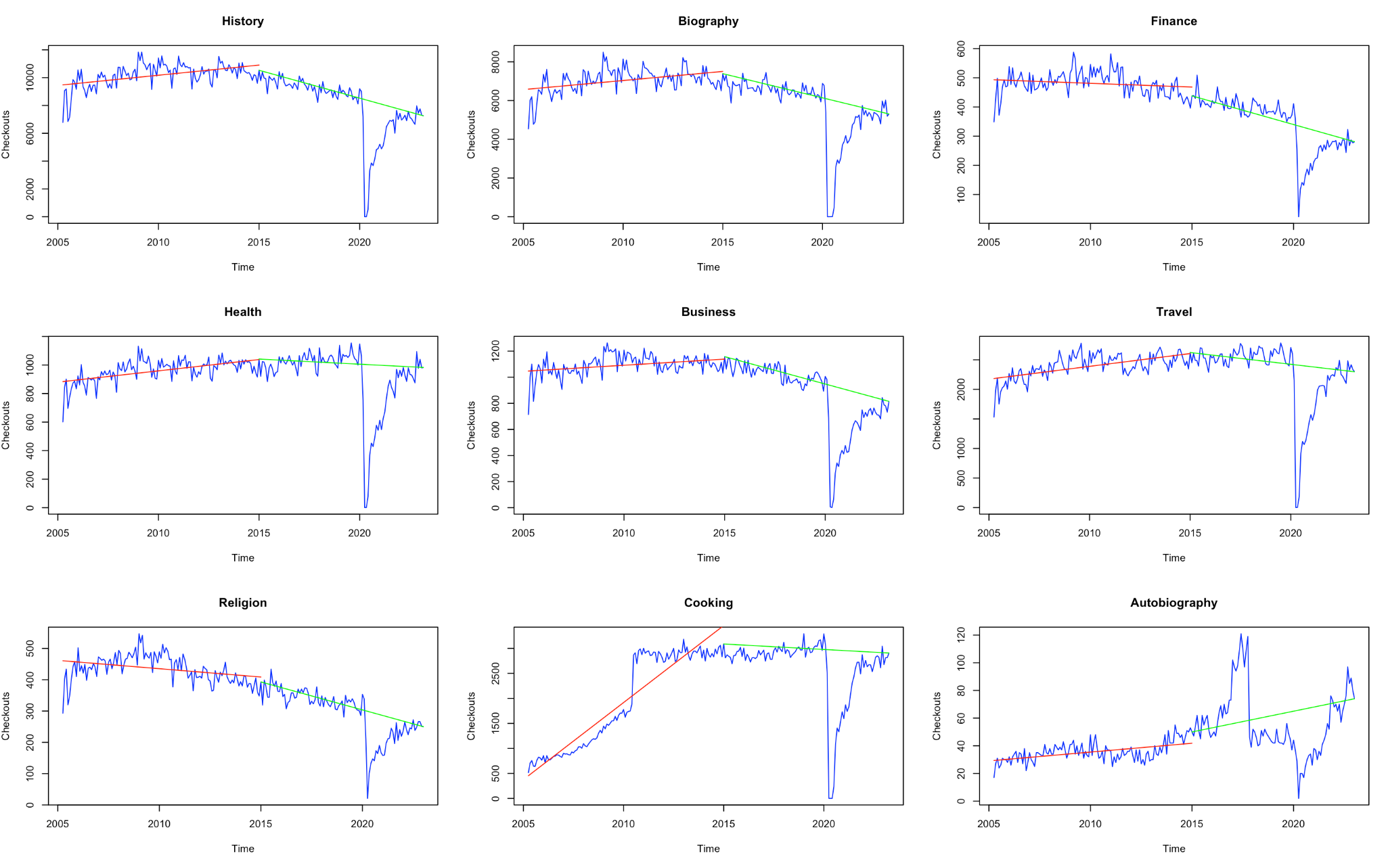
Non Fiction genres unique books checkouts
Mean monthly change rate
Genres\year period | 2005 - 2014 | 2015 - 2023
History | 2.1 | -3.8
Biography | 2.1 | -3.4
Finance | -0.7 | -4.5
Health | 2.6 | -0.7
Business | 1.3 | -3.6
Travel | 2.8 | -1.5
Religion | -1.8 | -4.5
cooking | 59.7 | -0.7
Autobiography | 7.6 | 6

Slide 12
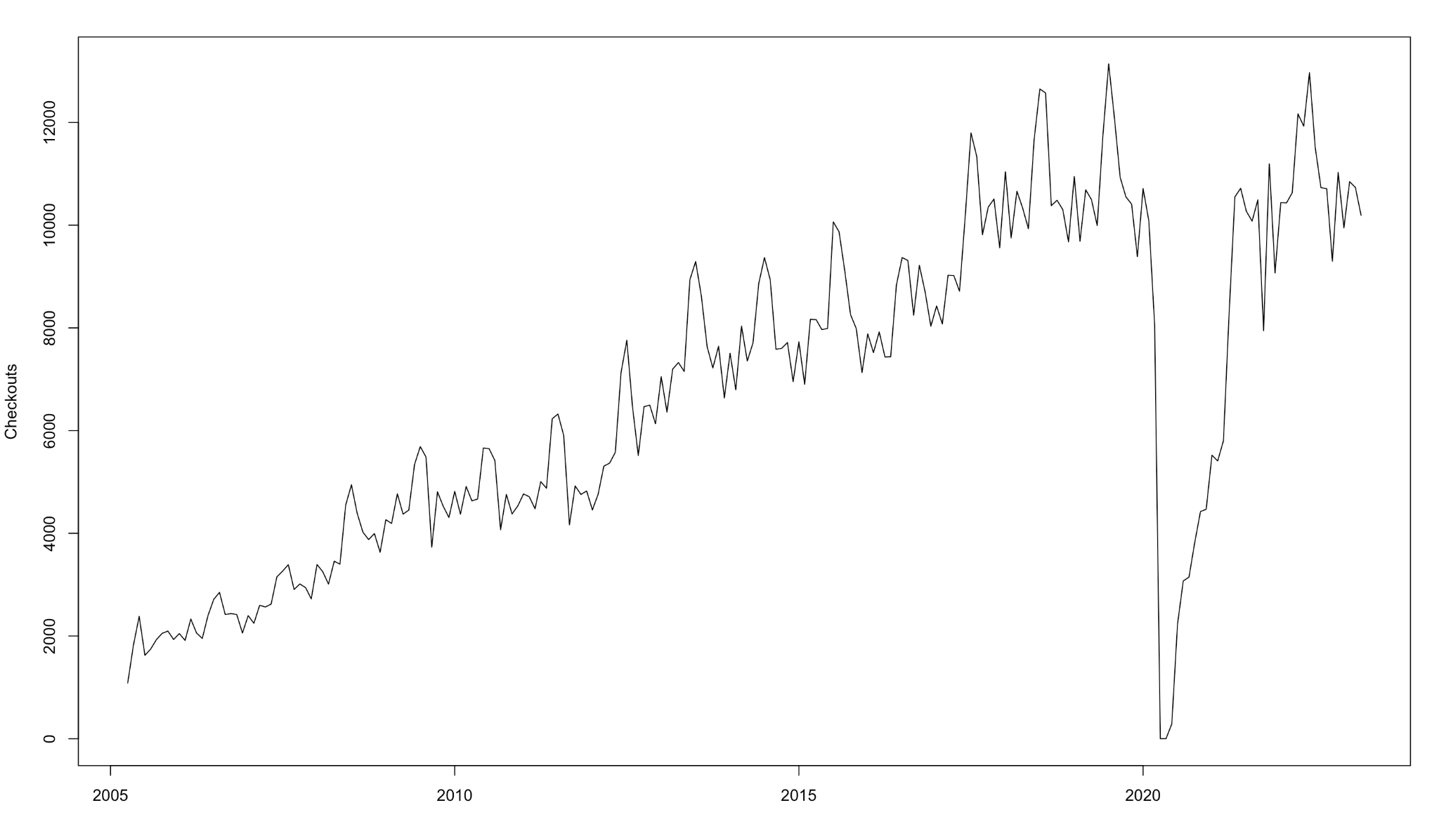
Books checkouts by genres Analysis
Analyze it using 2 Approaches:
1. TSLM with Auto Arima refinement 2. Auto Arima

Slide 13
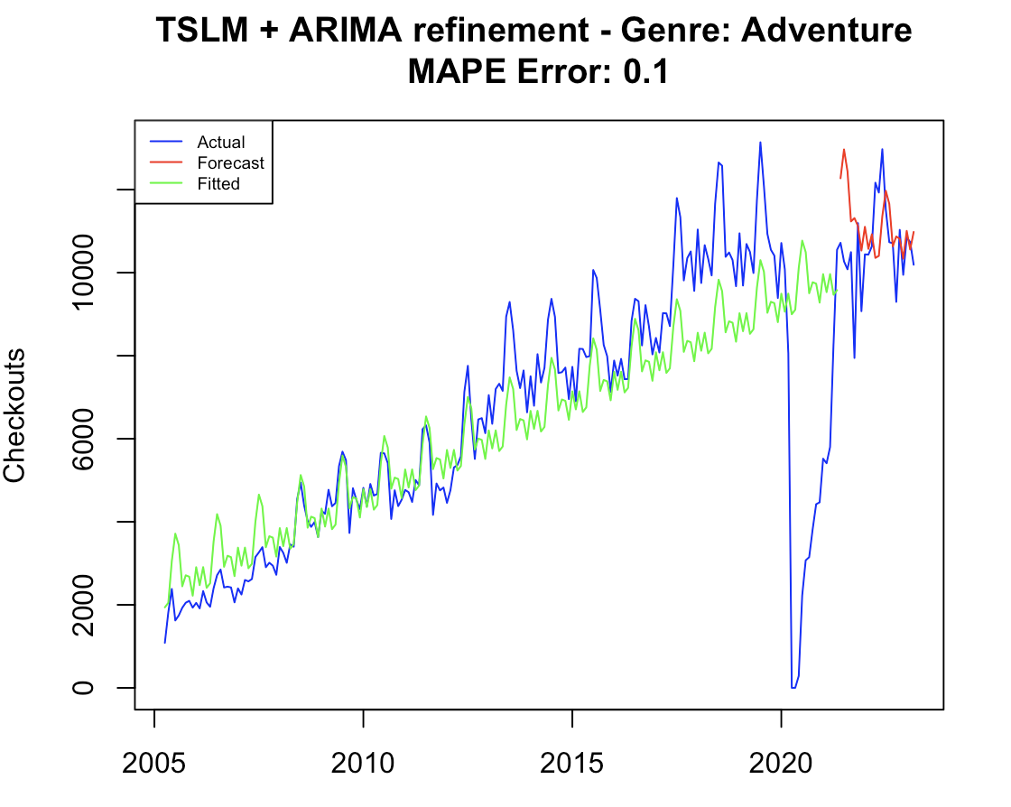
TSLM with Arima refinement on residuals
MAPE Error : 0.1 AIC : 3532

Slide 14
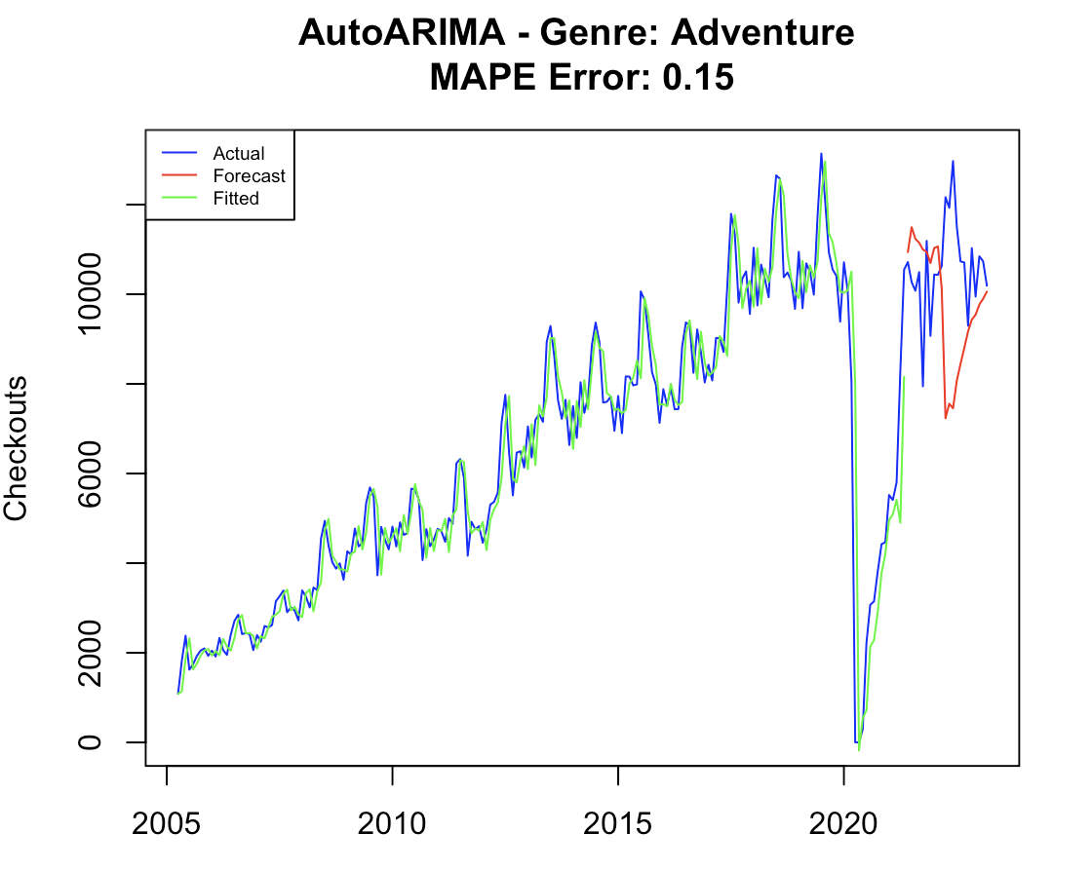
Arima model
MAPE Error : 0.15 AIC : 3185

Slide 15
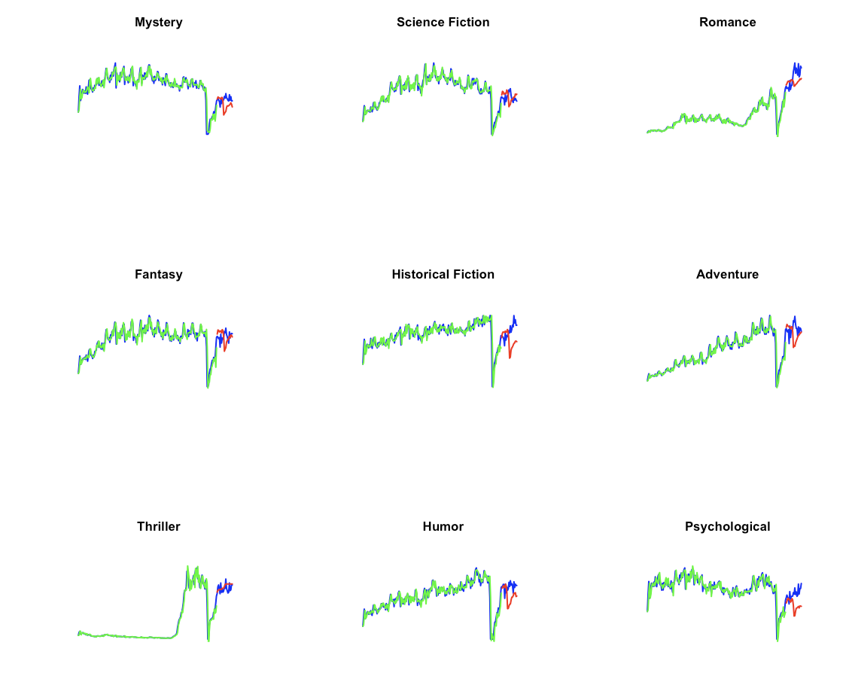
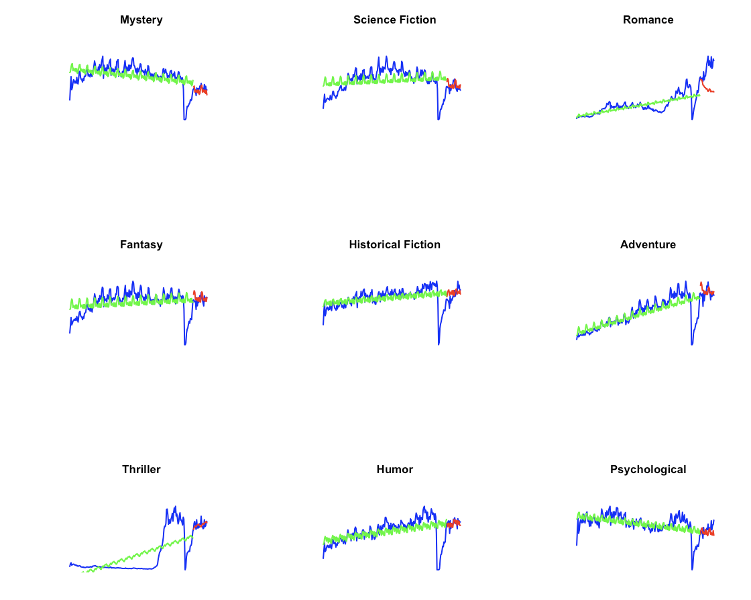
Assessing Book Checkout Forecasting For Fiction genres
Arima model: MAPE Error : 17% , AIC : 3205
TSLM with Arima refinement on residuals:
MAPE Error : 11% , AIC : 3618

Slide 16
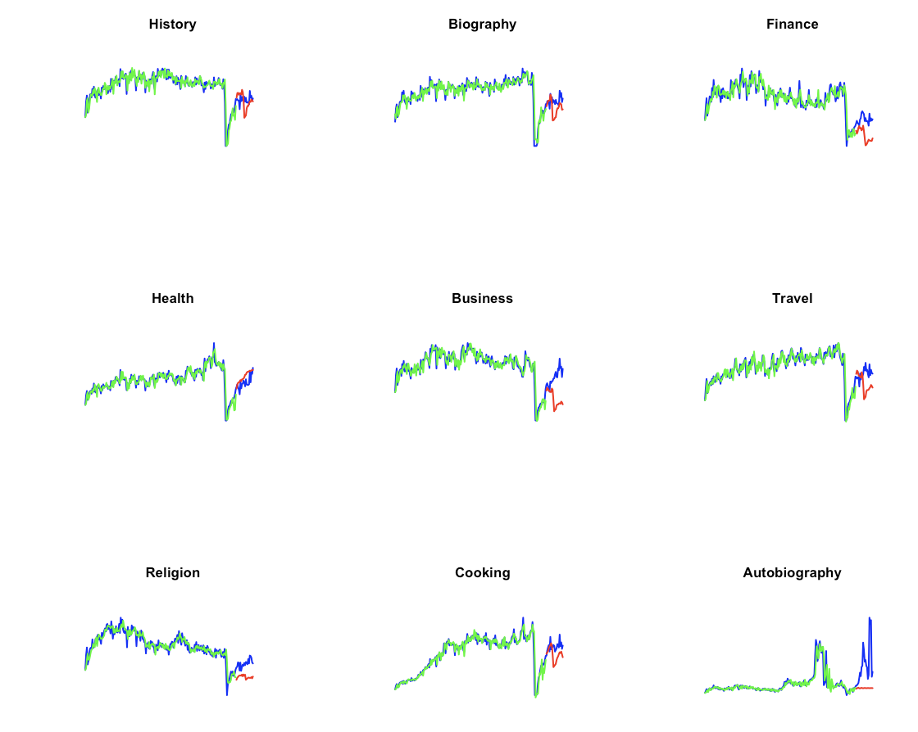
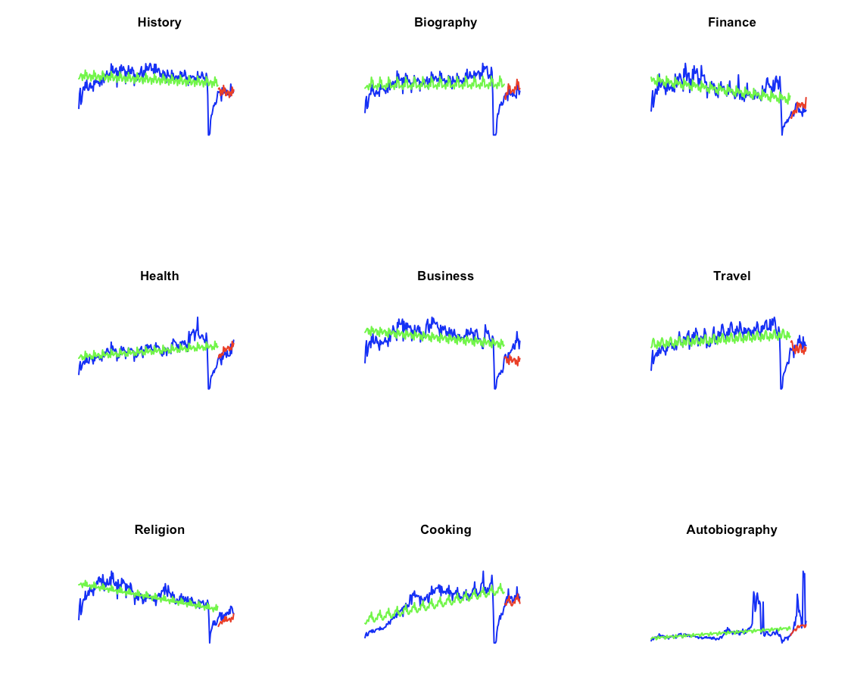
Assessing Book Checkout Forecasting For Non-Fiction genres
TSLM with Arima refinement on residuals:
MAPE Error : 17% , AIC : 3245
Arima model: MAPE Error : 31% , AIC : 2829

Slide 17
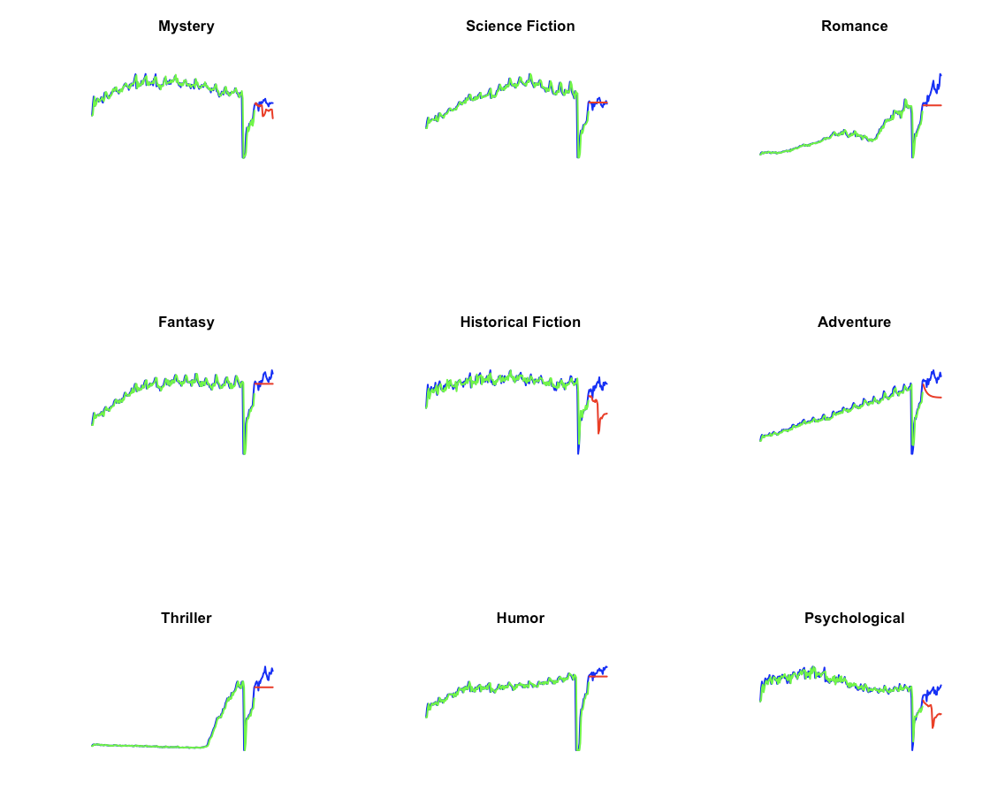
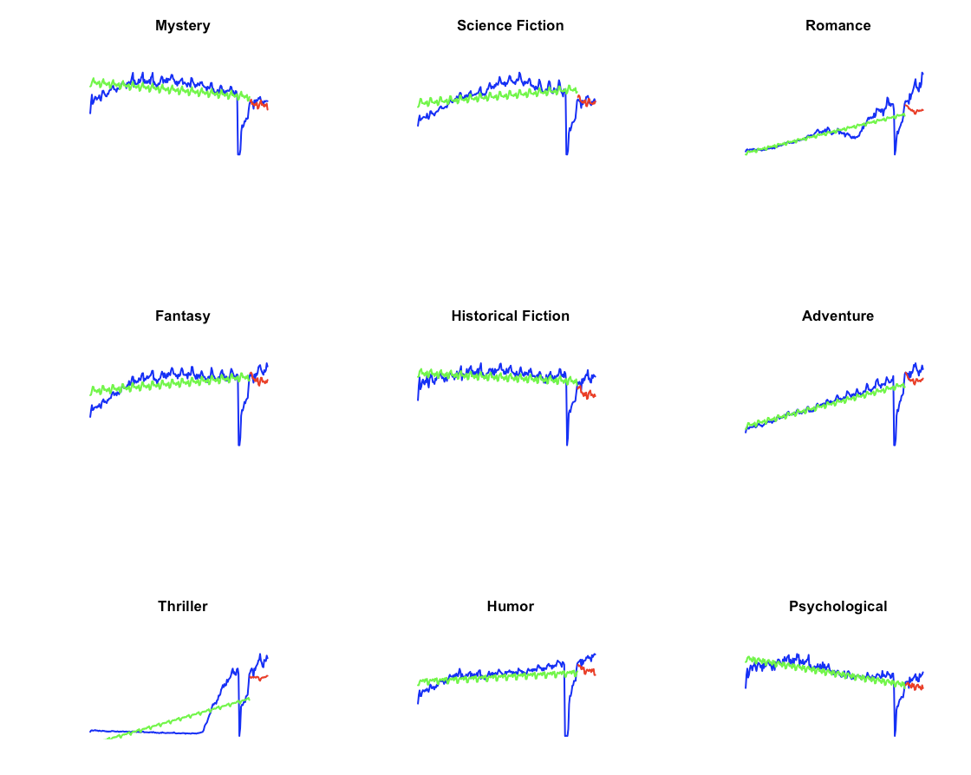
Assessing Unique Book Checkout Forecasting For Fiction genres
Arima model: MAPE Error : 17% , AIC : 2650
TSLM with Arima refinement on residuals:
MAPE Error : 13% , AIC : 2978

Slide 18
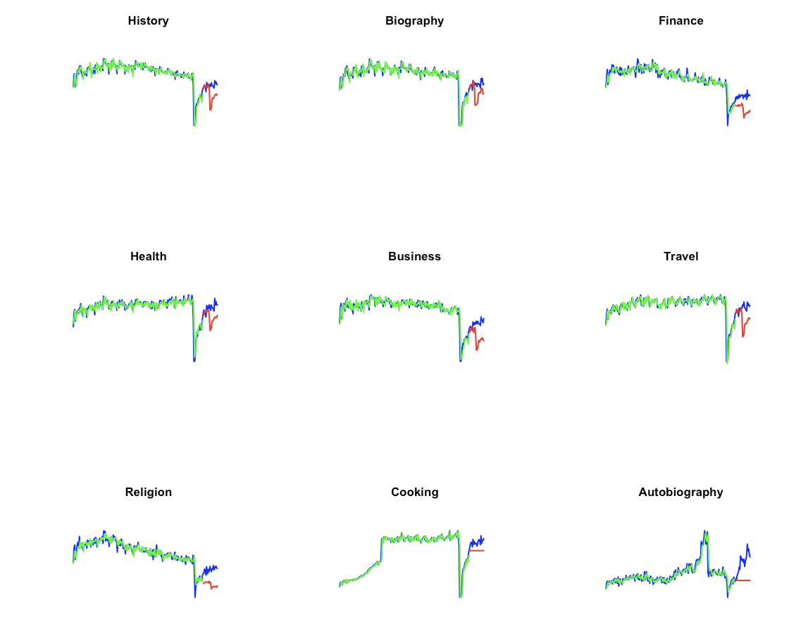
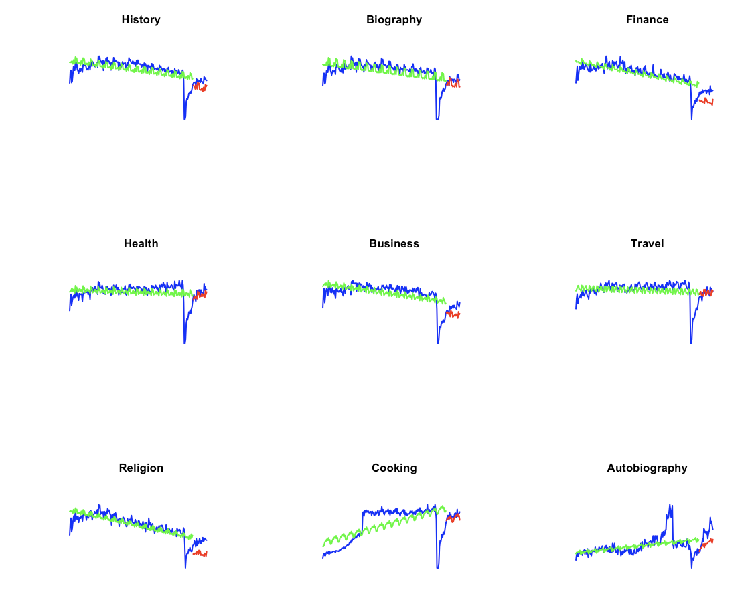
Assessing Unique Book Checkout Forecasting For Fiction genres
Arima model: MAPE Error : 29% , AIC : 2360
TSLM with Arima refinement on residuals:
MAPE Error : 18% , AIC : 2656

Slide 19
TSLM vs Auto Arima
Analyzing the model's performance through 36 charts, categorized by various genres,
employing two distinct metrics for assessment.
Arima model
MAPE Error : 23% AIC : 2761
TSLM with Arima refinement
MAPE Error : 15% AIC : 3124
MAPE error: A lower MAPE error indicates a better accuracy in predictions
AIC : A lower AIC value indicates a better balance between the model fix and complexity

Slide 20
Time Series Objects
Analysis of how the average number of checkouts per unique book changes over time
Unique Checkouts: The ratio of total book checkouts to the count of unique books
ts_checkouts_per_unique <- total_time_series / detailed_ts_books
total_time_series: A time series of total book checkouts over time.
detailed_ts_books: A time series of unique book counts over time.
Filtered Unique Checkouts:
Using percentiles of the single book checkout distribution in a month
50th percentile defines the threshold for unique checkouts with at least 3 checkouts
95th percentile defines the threshold for unique checkouts with at least 10 checkouts

Slide 21
Time Series Objects
Unique Checkouts with at least 3 checkouts:
ts_filtered3_checkouts_per_unique <- ts_filtered3_total_checkouts / ts_filtered3_unique
ts_filtered3_total_checkouts: A time series of total book checkouts per month with a minimum threshold of 3 checkouts
ts_filtered3_unique: A time series of the count of unique titles per month where each title has more than 3 checkouts.
Unique Checkouts with at least 10 checkouts:
ts_filtered10_checkouts_per_unique <- ts_filtered10_total_checkouts/ts_filtered10_unique
ts_filtered3_total_checkouts: A time series of total book checkouts per month with a minimum threshold of 10 checkouts
ts_filtered3_unique: A time series of the count of unique titles per month where each title has more than 10 checkouts.

Slide 22
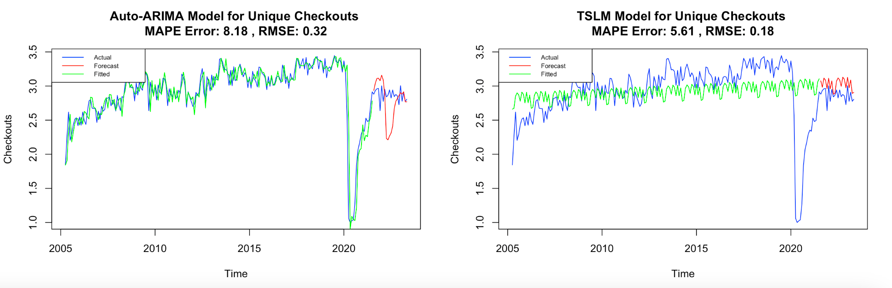
Model Comparison for Unique Checkouts
Auto-ARIMA and TSLM application on number of checkouts per unique book
90% training data and 10% testing data
Auto-ARIMA Results:
ARIMA(0,1,1)(2,0,0)[12] RMSE: 0.32
ARIMA(0,1,1)(2,0,0)[12] MAPE: 8.18%
TSLM Results:
TSLM RMSE: 0.18
TSLM MAPE: 5.61%

Slide 23
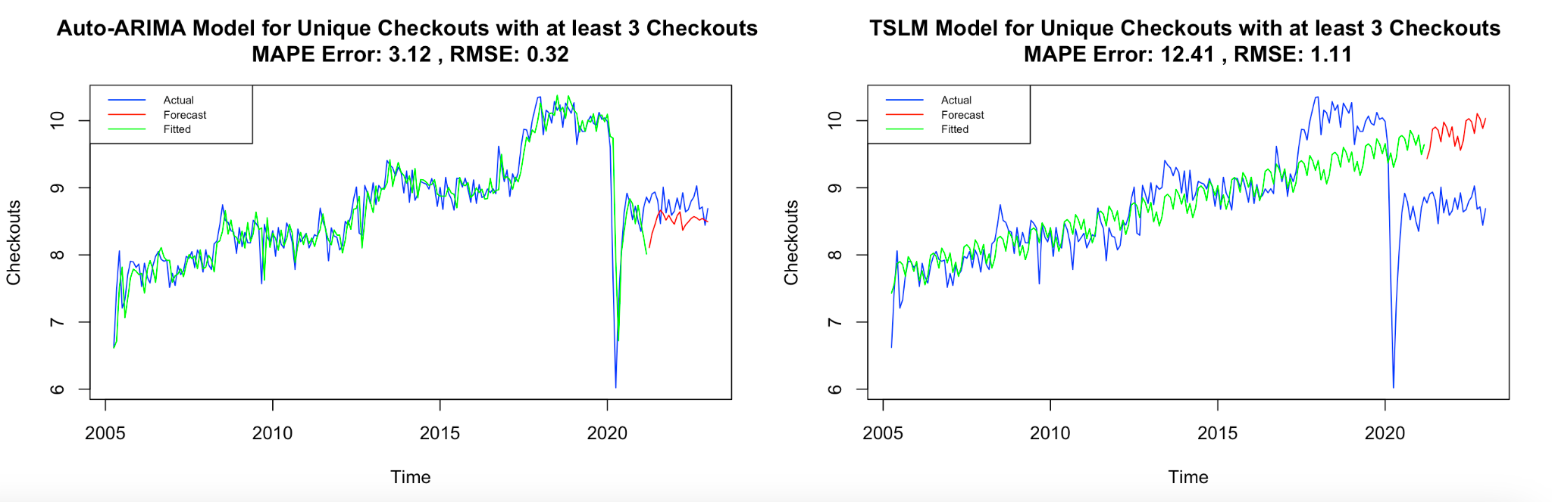
Model Comparison for Filtered Unique Checkouts > 3
Auto-ARIMA and TSLM application on number of checkouts per unique book with at least 3 checkouts
Auto-ARIMA Results:
ARIMA(2,1,1)(1,0,0)[12] RMSE: 0.32
ARIMA(2,1,1)(1,0,0)[12] MAPE: 3.12%
TSLM Results:
TSLM RMSE: 1.11
TSLM MAPE: 12.41%

Slide 24
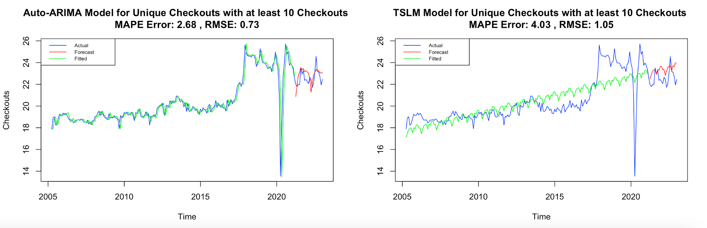
Model Comparison for Filtered Unique Checkouts > 10
Auto-ARIMA and TSLM application on number of checkouts per unique book with at least 10 checkouts
Auto-ARIMA Results:
ARIMA(0,1,0)(0,0,2)[12] RMSE: 0.73
ARIMA(0,1,0)(0,0,2)[12] MAPE: 2.68%
TSLM Results:
TSLM RMSE: 1.05
TSLM MAPE: 4.03%

Slide 25
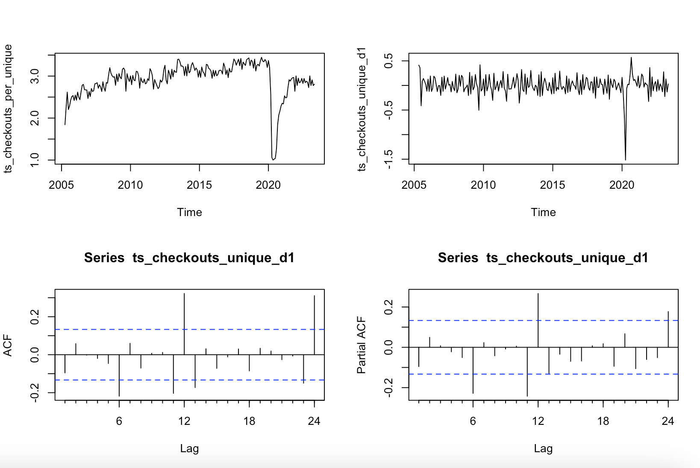
Selecting ARIMA Parameters for Unique Checkouts
1st differencing to make it stationary
Significant values
Lag order (p) = 6
Degree of differencing (d) = 1
Order of the moving average (q) = 6

Slide 26
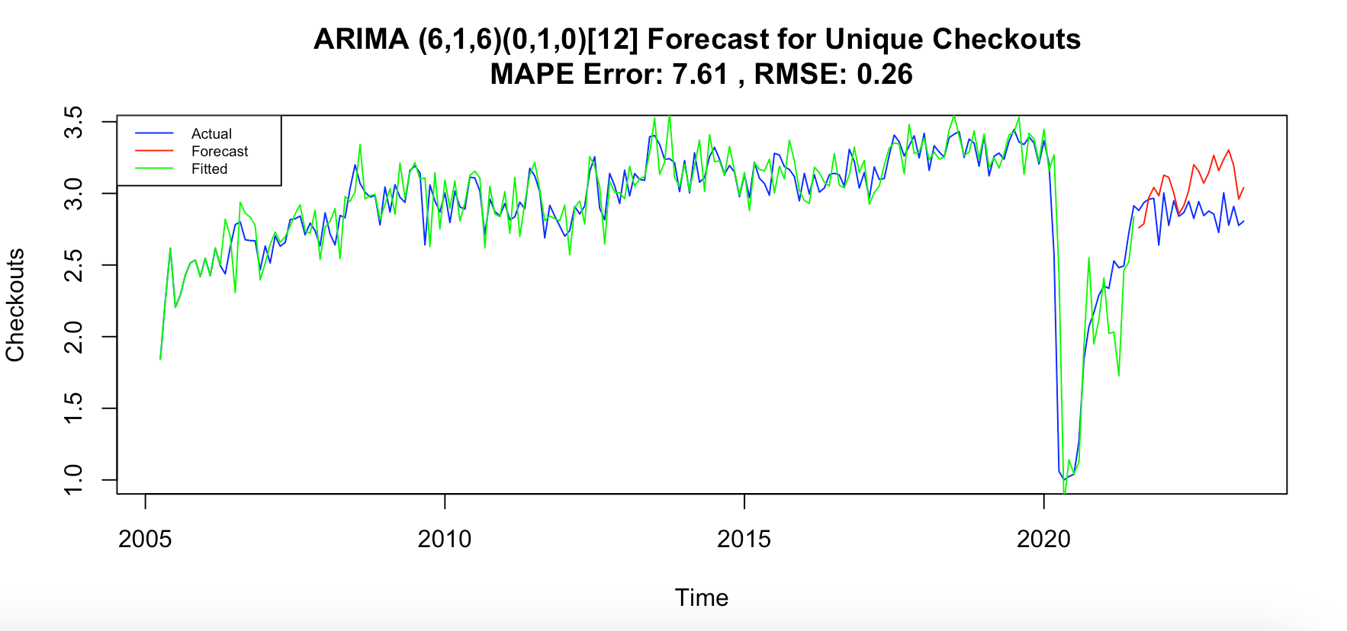
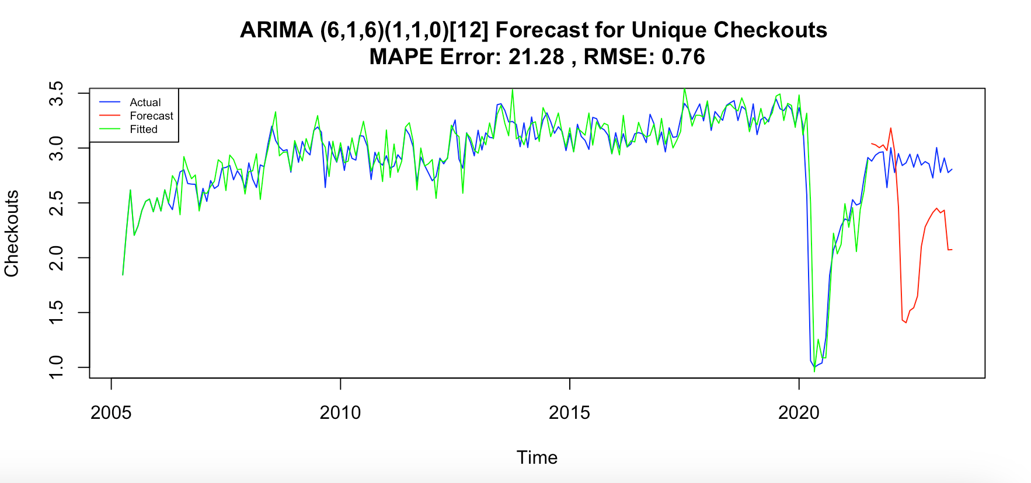
ARIMA Results for Unique Checkouts
ARIMA application on number of checkouts per unique book
Two models with manually defined parameters
Train (0.9) - Test (0.1) set split
ARIMA(6,1,6)(0,1,0)[12] RMSE: 0.26
ARIMA(6,1,6)(0,1,0)[12] MAPE: 7.61%
ARIMA(6,1,6)(1,1,0)[12] RMSE: 0.76
ARIMA(6,1,6)(1,1,0)[12] MAPE: 21.28%

Slide 27
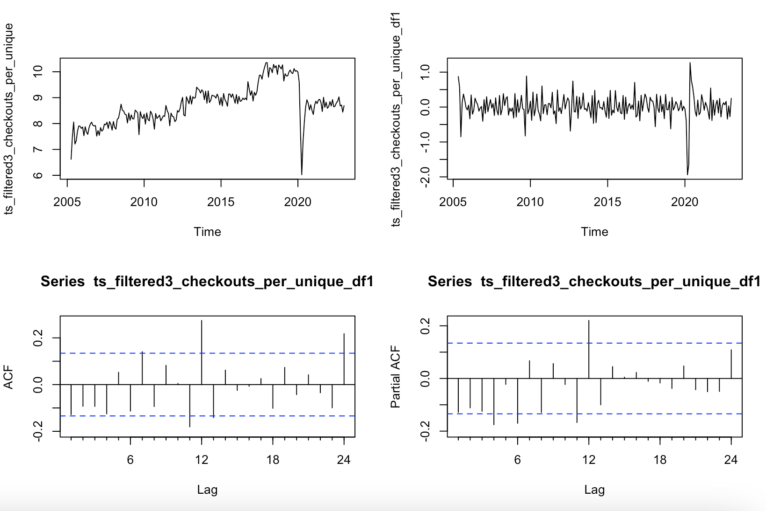
Selecting ARIMA Parameters for Unique Checkouts > 3
1st differencing to make it stationary
Significant values
Lag order (p) = 4
Degree of differencing (d) = 1
Order of the moving average (q) = 7

Slide 28
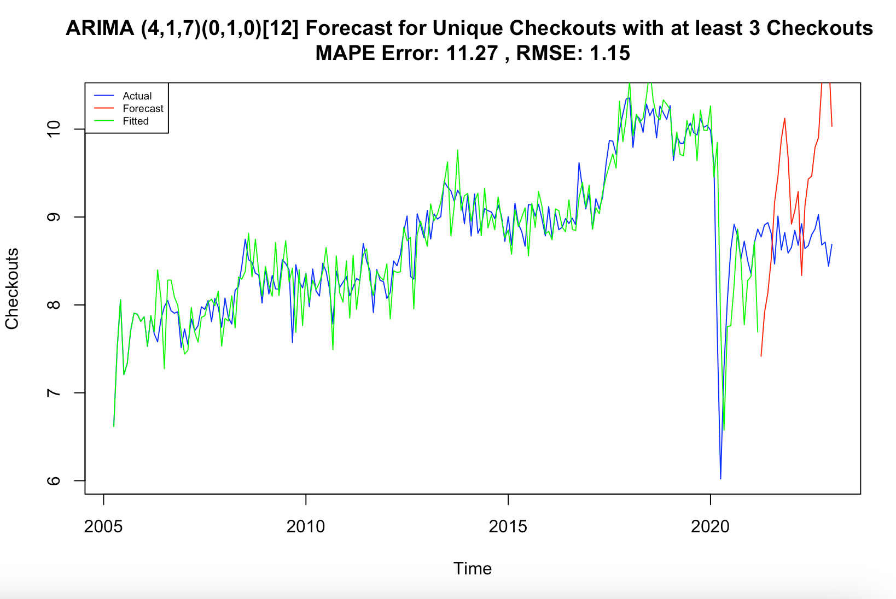
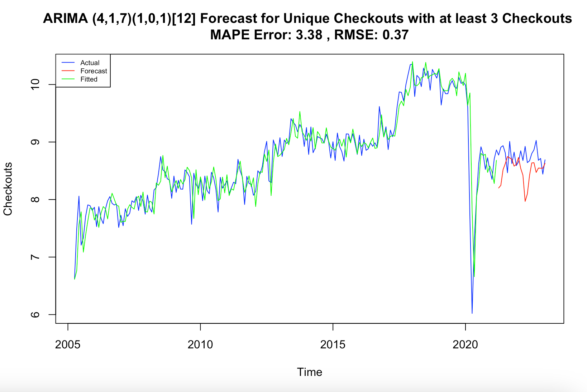
ARIMA Results for Filtered Unique Checkouts > 3
ARIMA application on number of checkouts per unique book with at least 3 checkouts
Two models with manually defined parameters
Train (0.9) - Test (0.1) set split
ARIMA(4,1,7)(0,1,0)[12] RMSE: 1.15
ARIMA(4,1,7)(0,1,0)[12] MAPE: 11.27%
ARIMA(4,1,6)(0,1,0)[12] RMSE: 0.37
ARIMA(4,1,6)(0,1,0)[12] MAPE: 3.38%

Slide 29
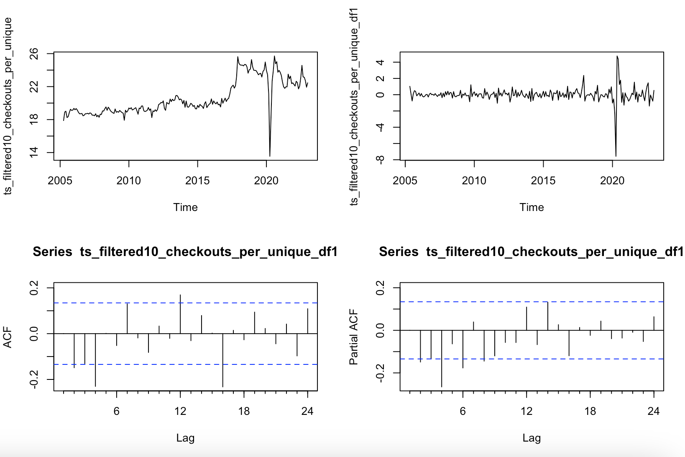
Selecting ARIMA Parameters for Unique Checkouts > 10
1st differencing to make it stationary
Significant values
Lag order (p) = 2
Degree of differencing (d) = 1
Order of the moving average (q) = 2

Slide 30
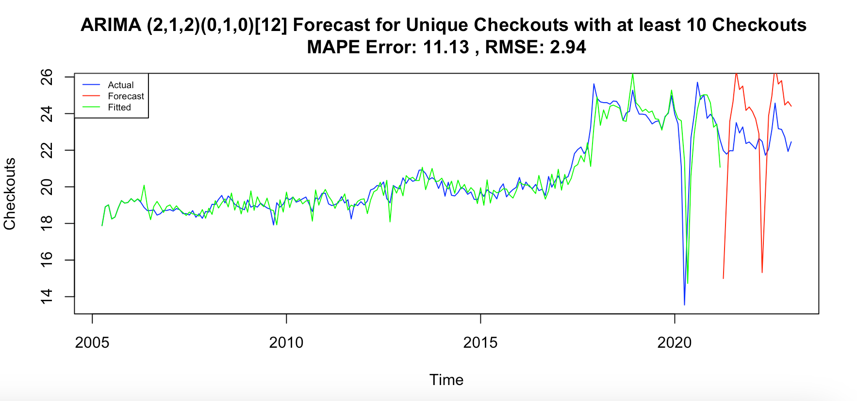
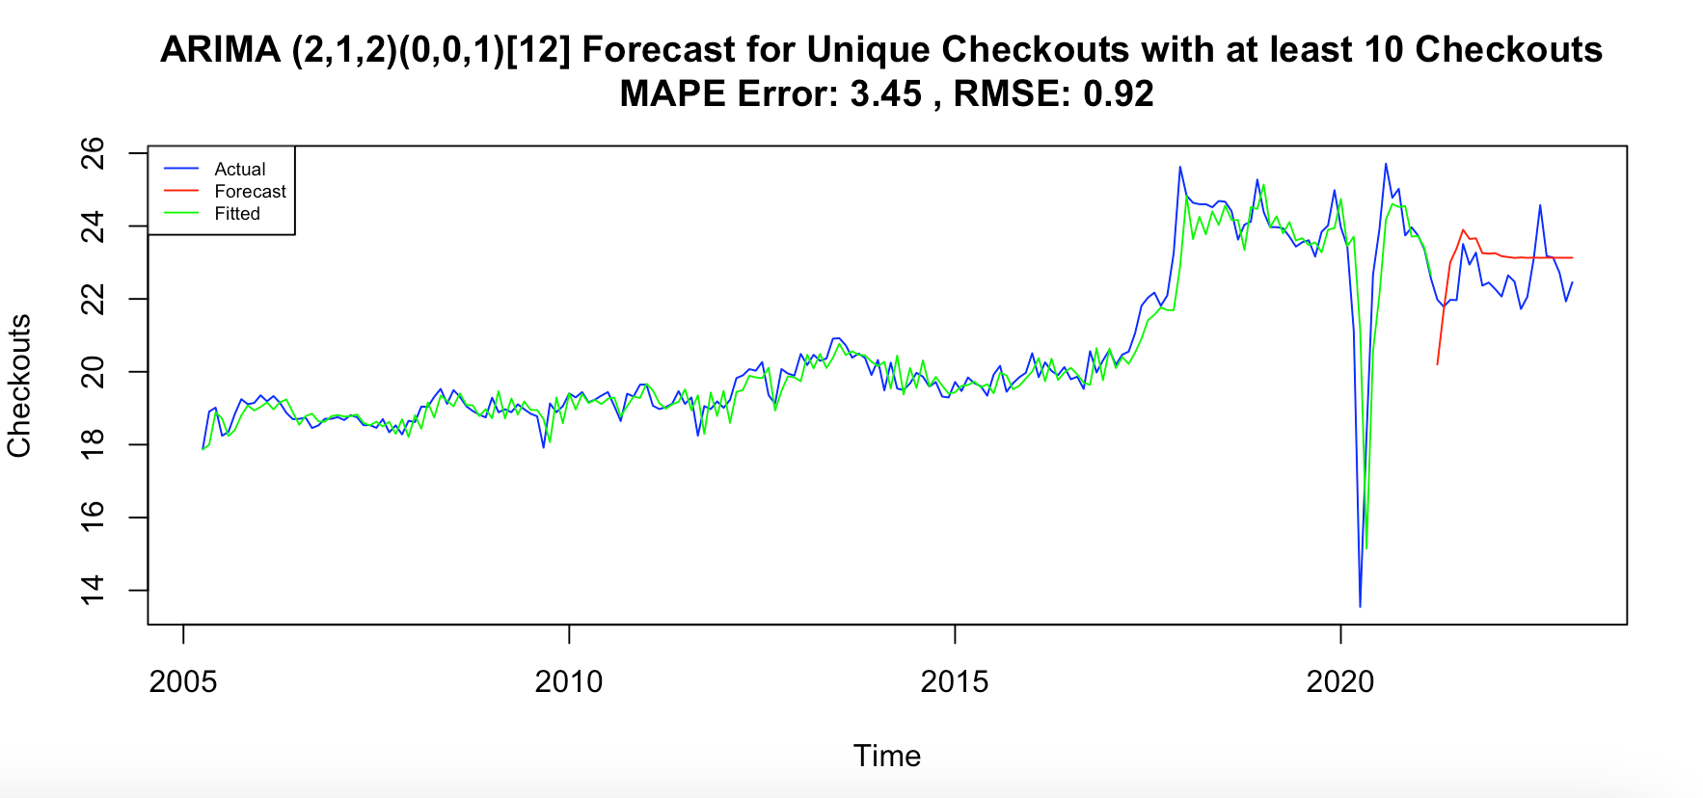
ARIMA Results for Filtered Unique Checkouts > 10
ARIMA application on number of checkouts per unique book with at least 10 checkouts
Two models with manually defined parameters
Train (0.9) - Test (0.1) set split
ARIMA(2,1,2)(0,1,0)[12] RMSE: 2.94
ARIMA(2,1,2)(0,1,0)[12] MAPE: 11.13%
ARIMA(2,1,2)(0,0,1)[12] RMSE: 0.92
ARIMA(2,1,2)(0,0,1)[12] MAPE: 3.45%

Slide 31
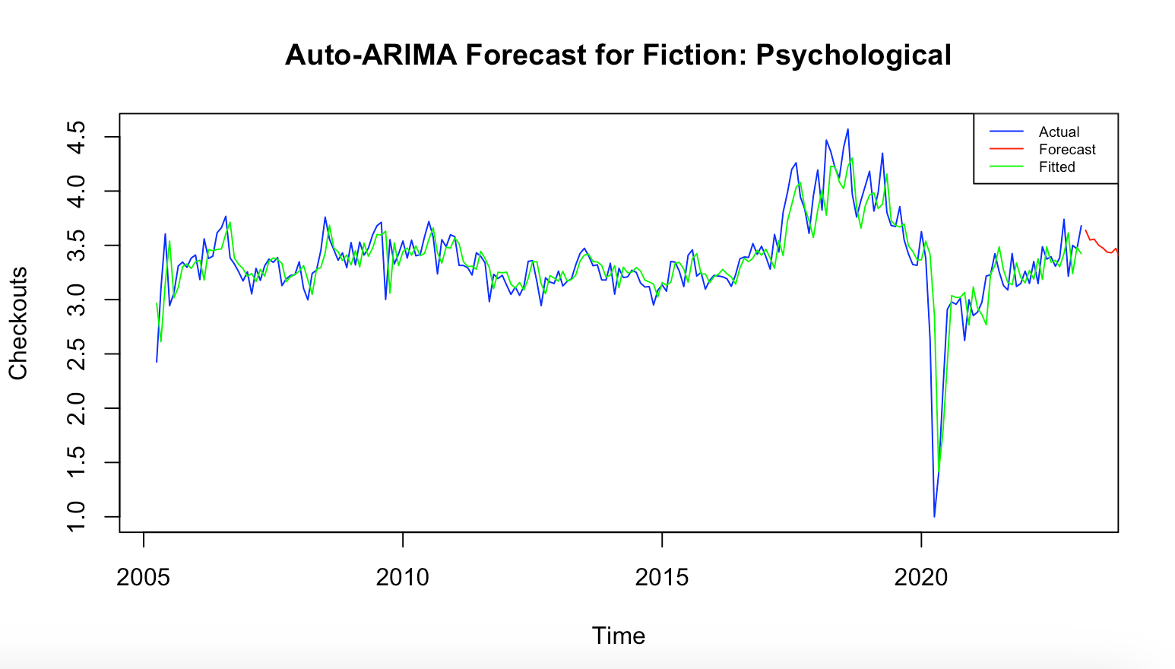
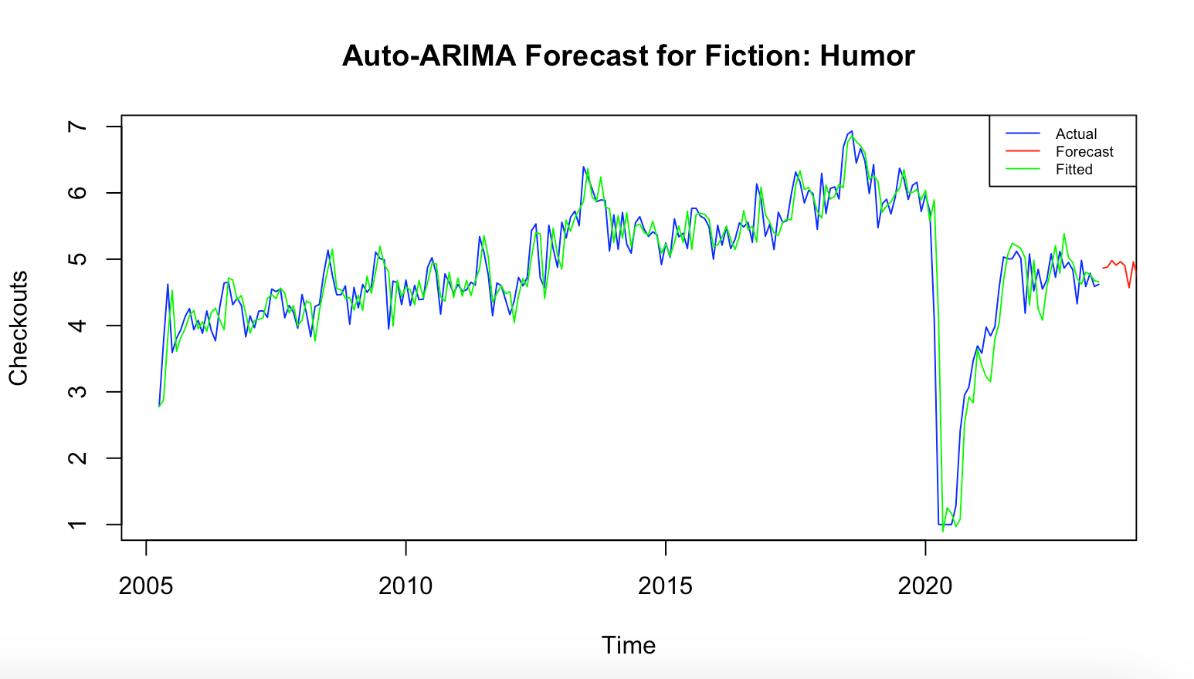
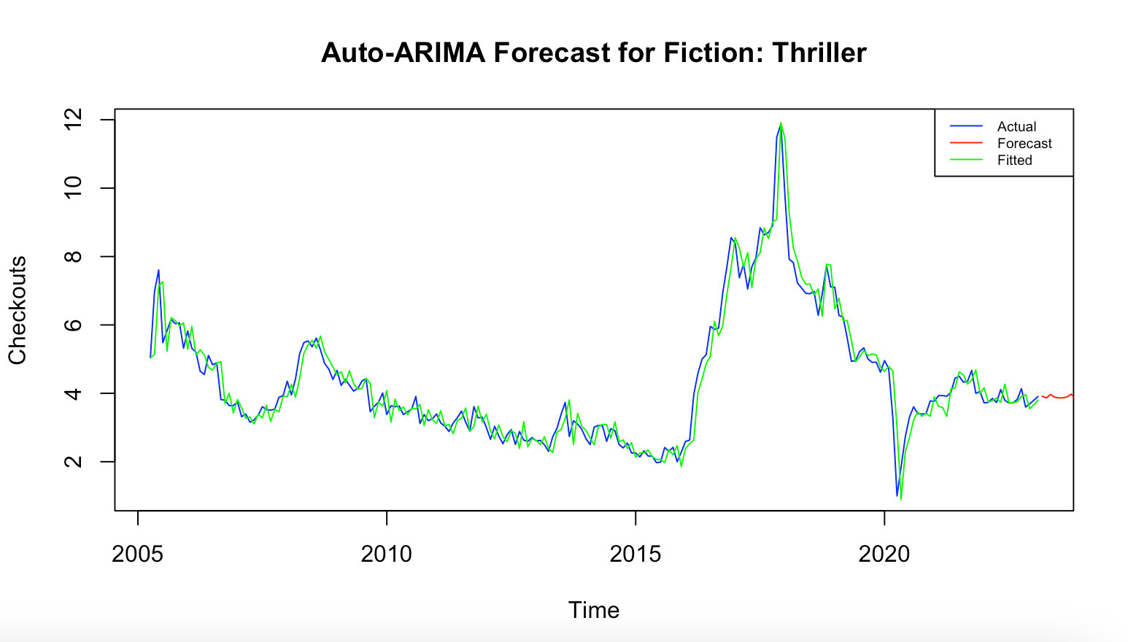
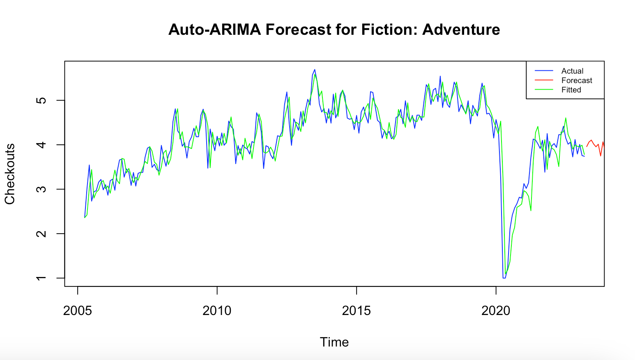
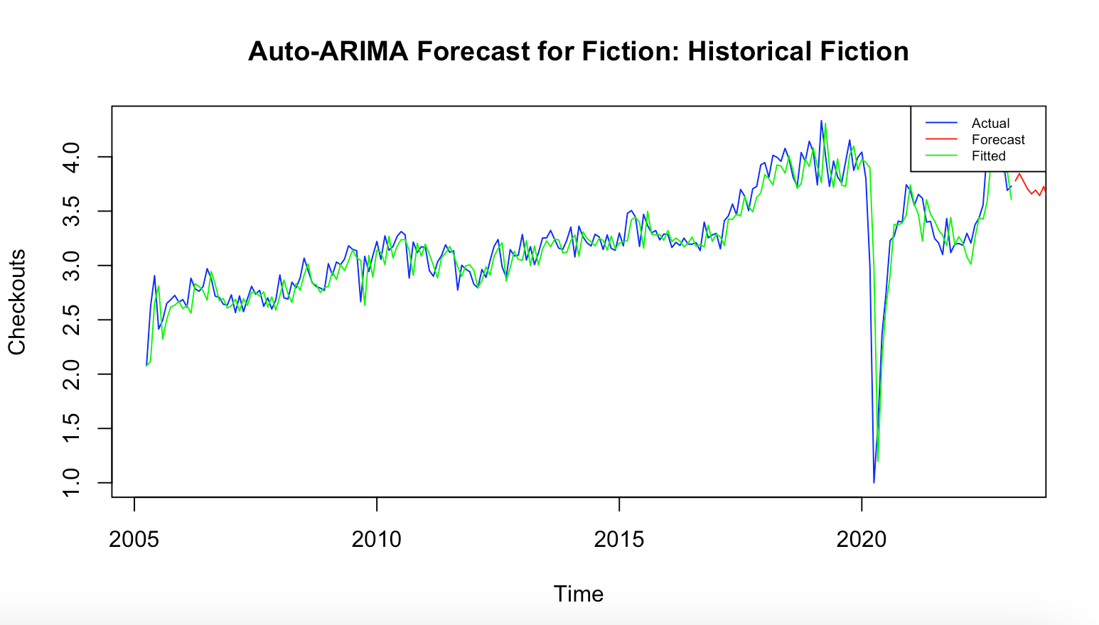
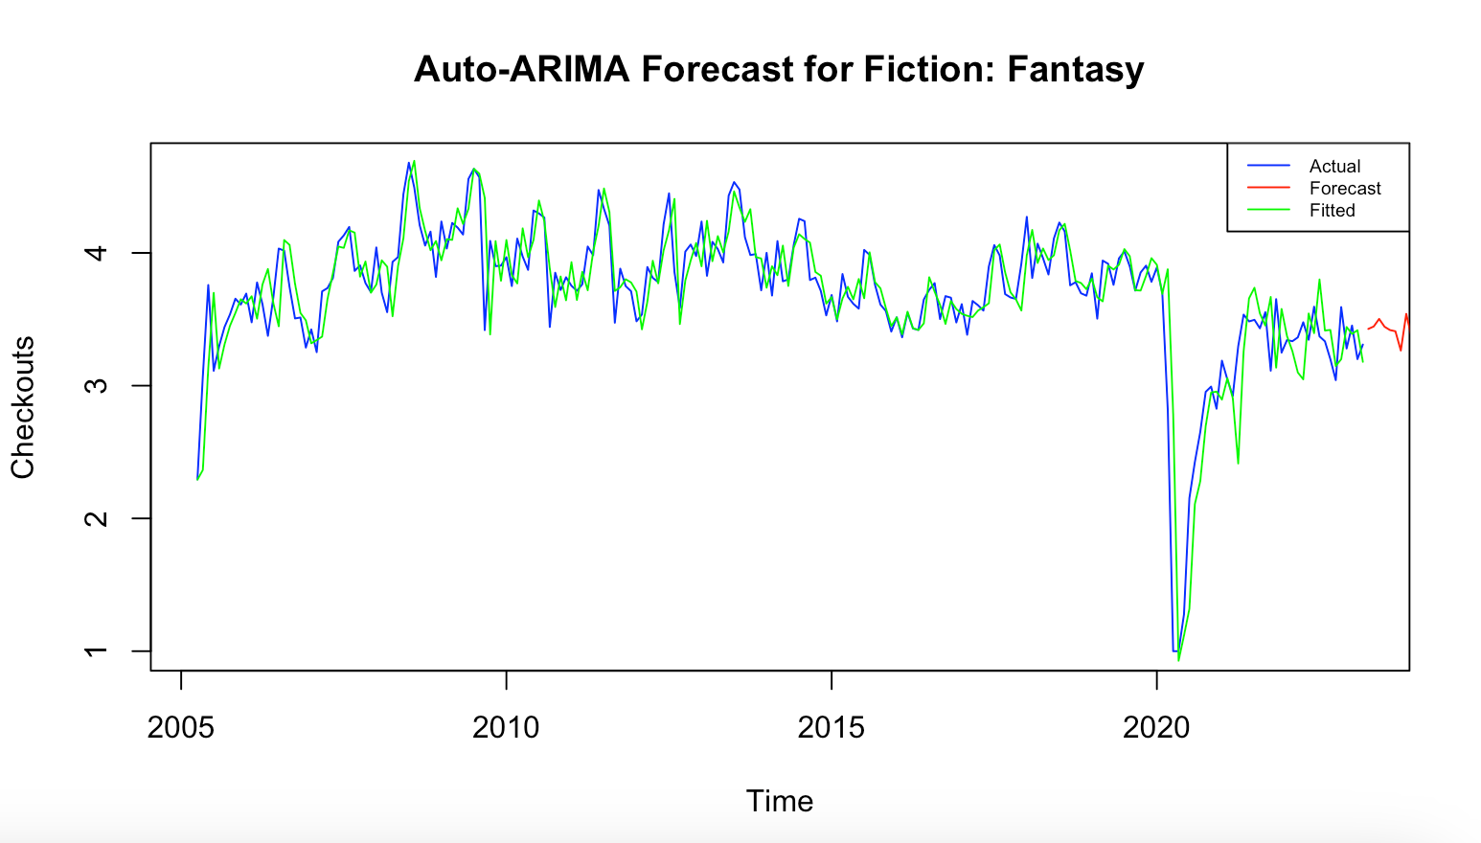
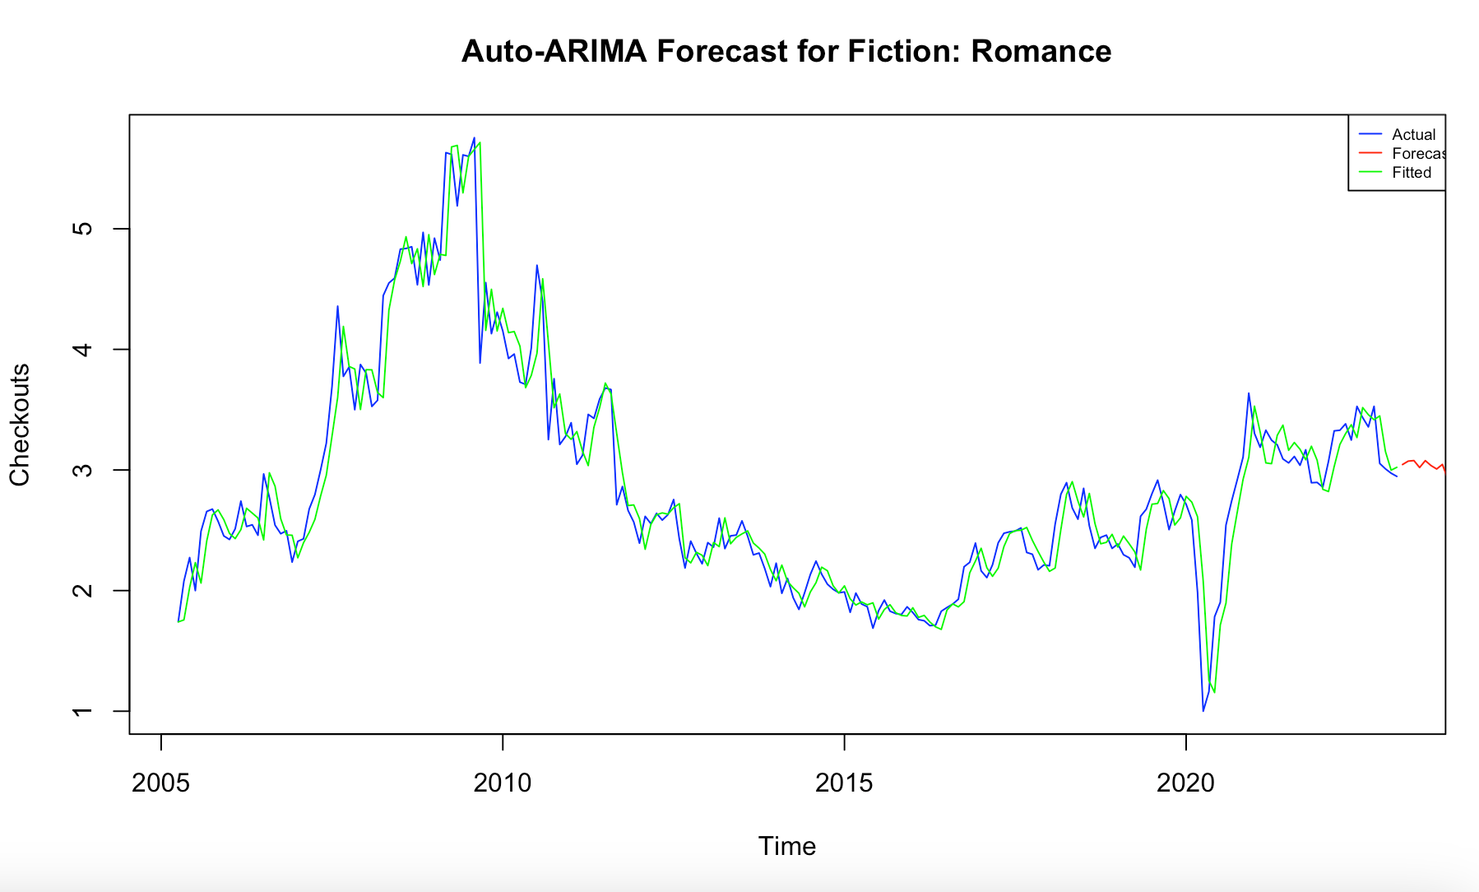
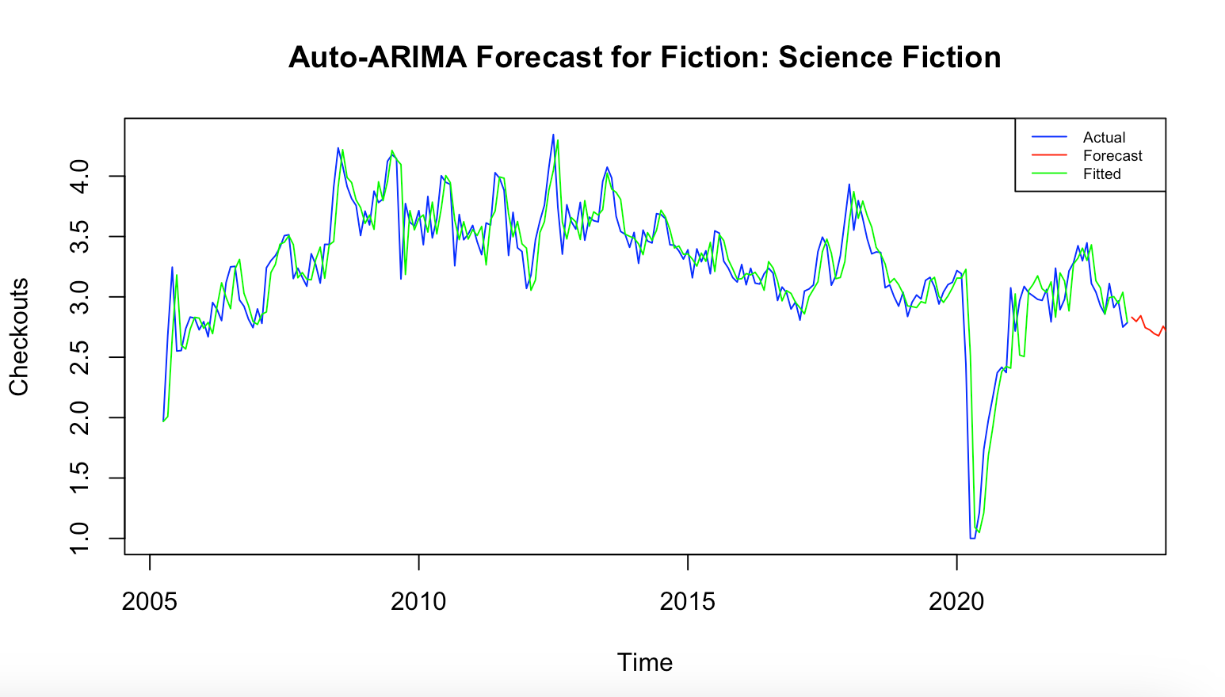
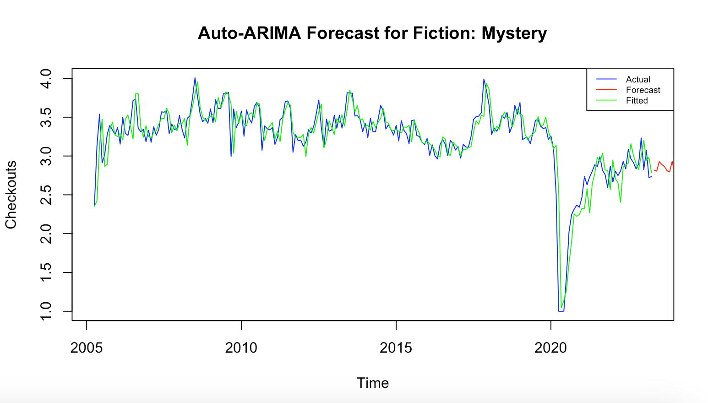
Auto-ARIMA 12 Months Forecast for Single Genre Fiction Books

Slide 32
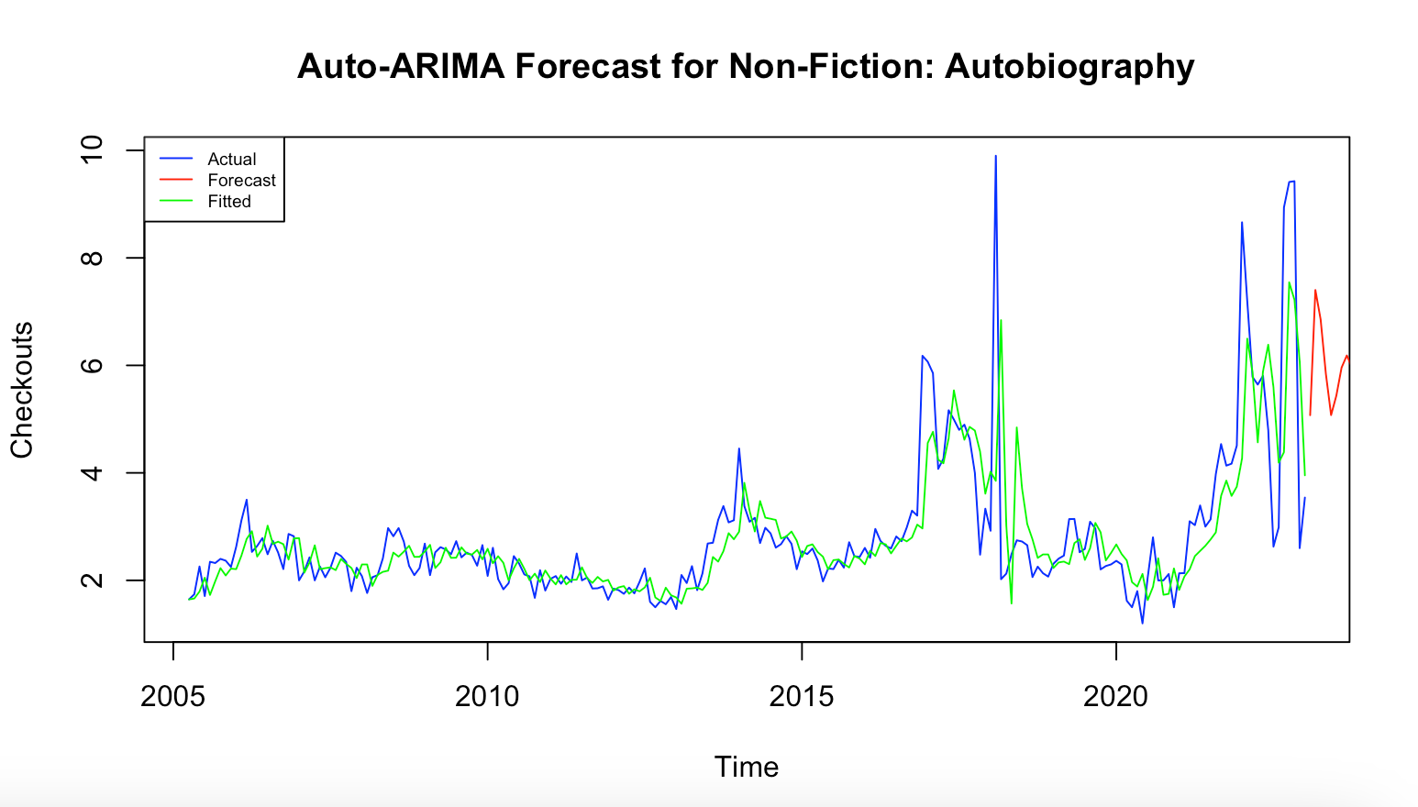
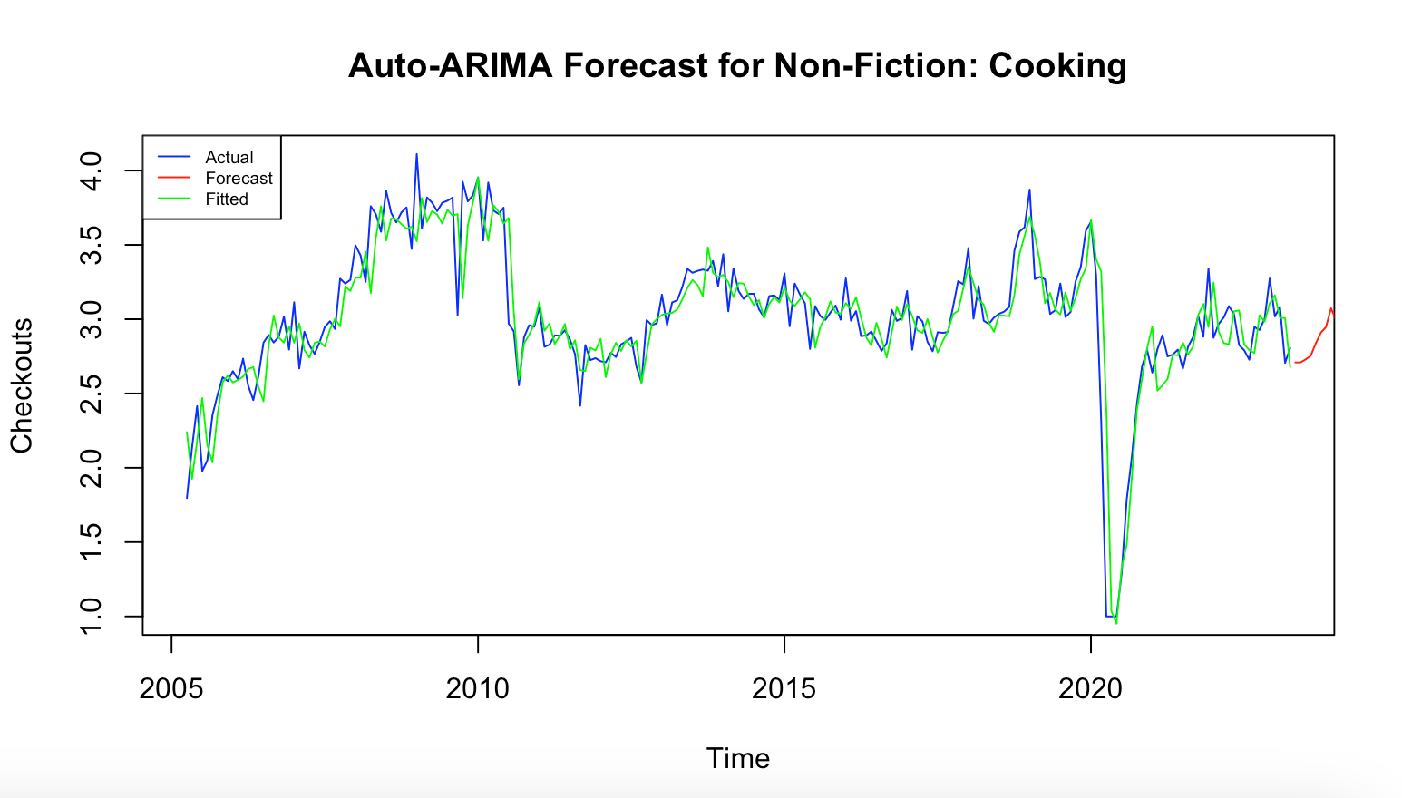
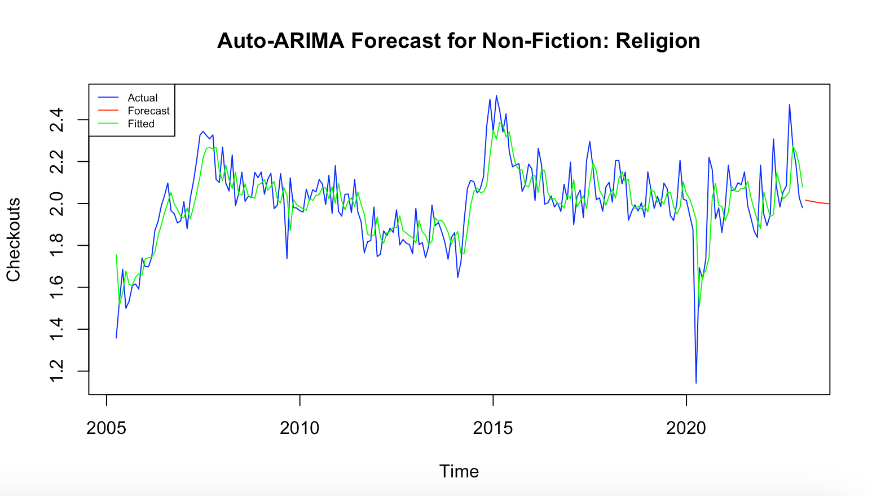
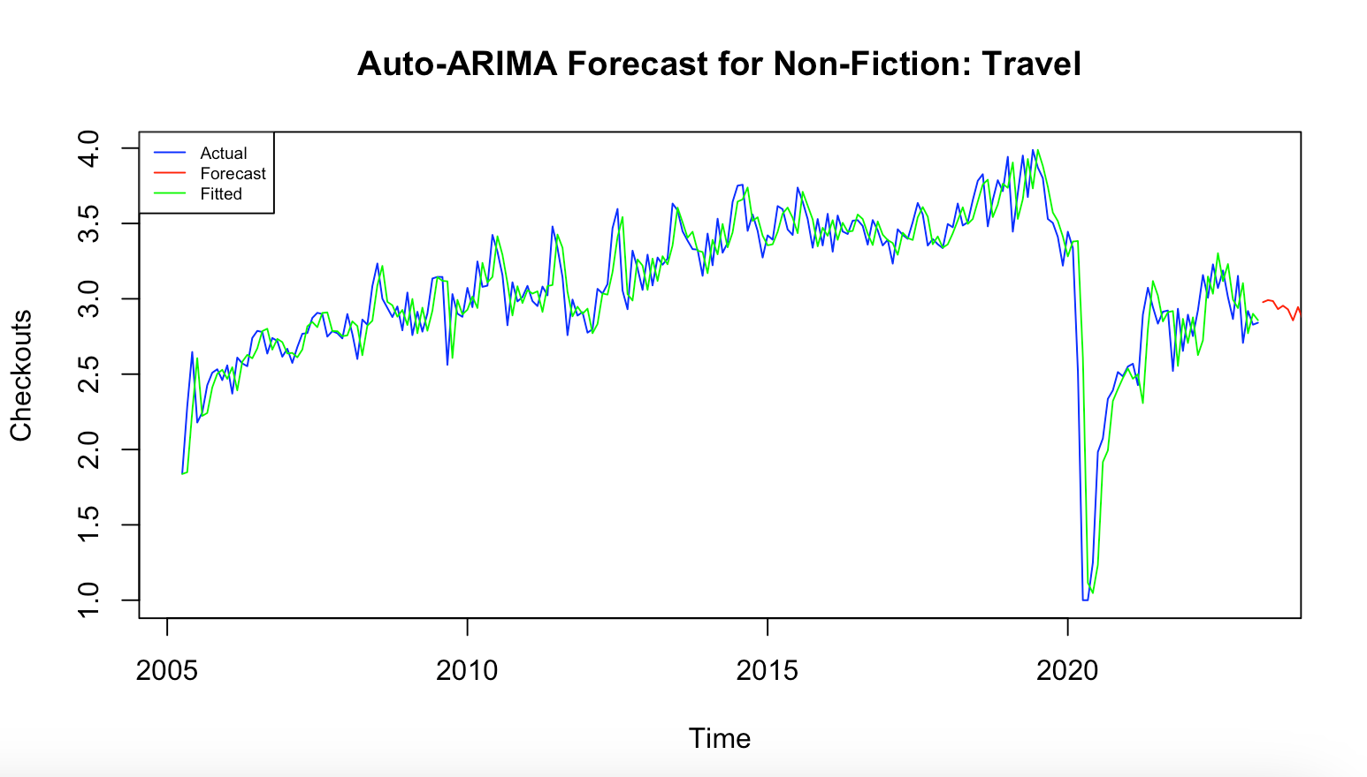
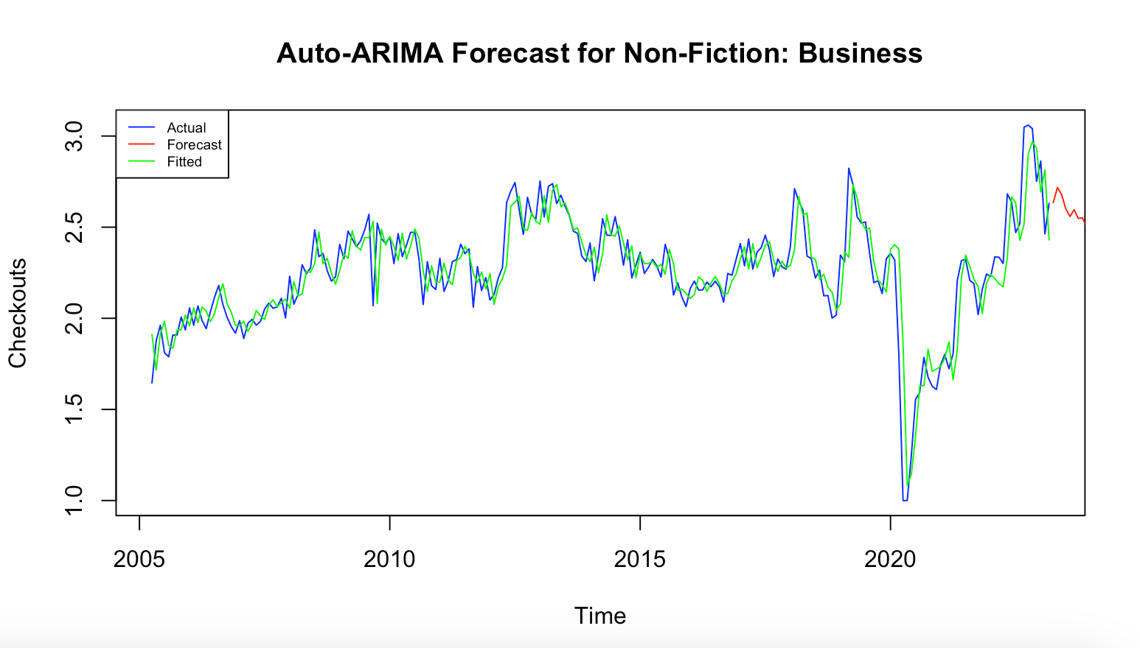
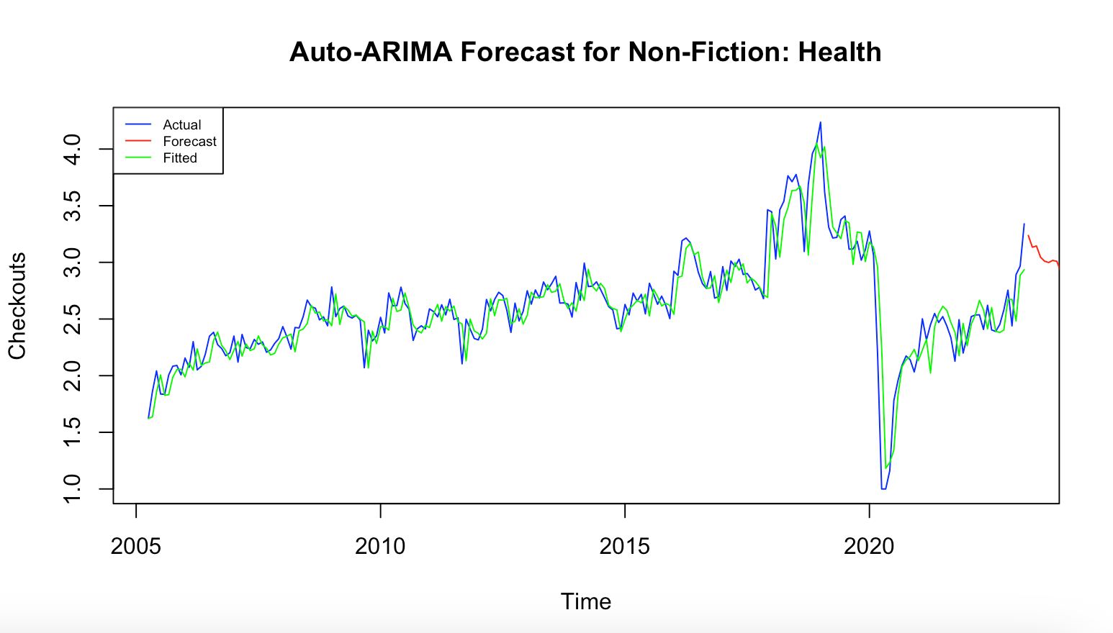
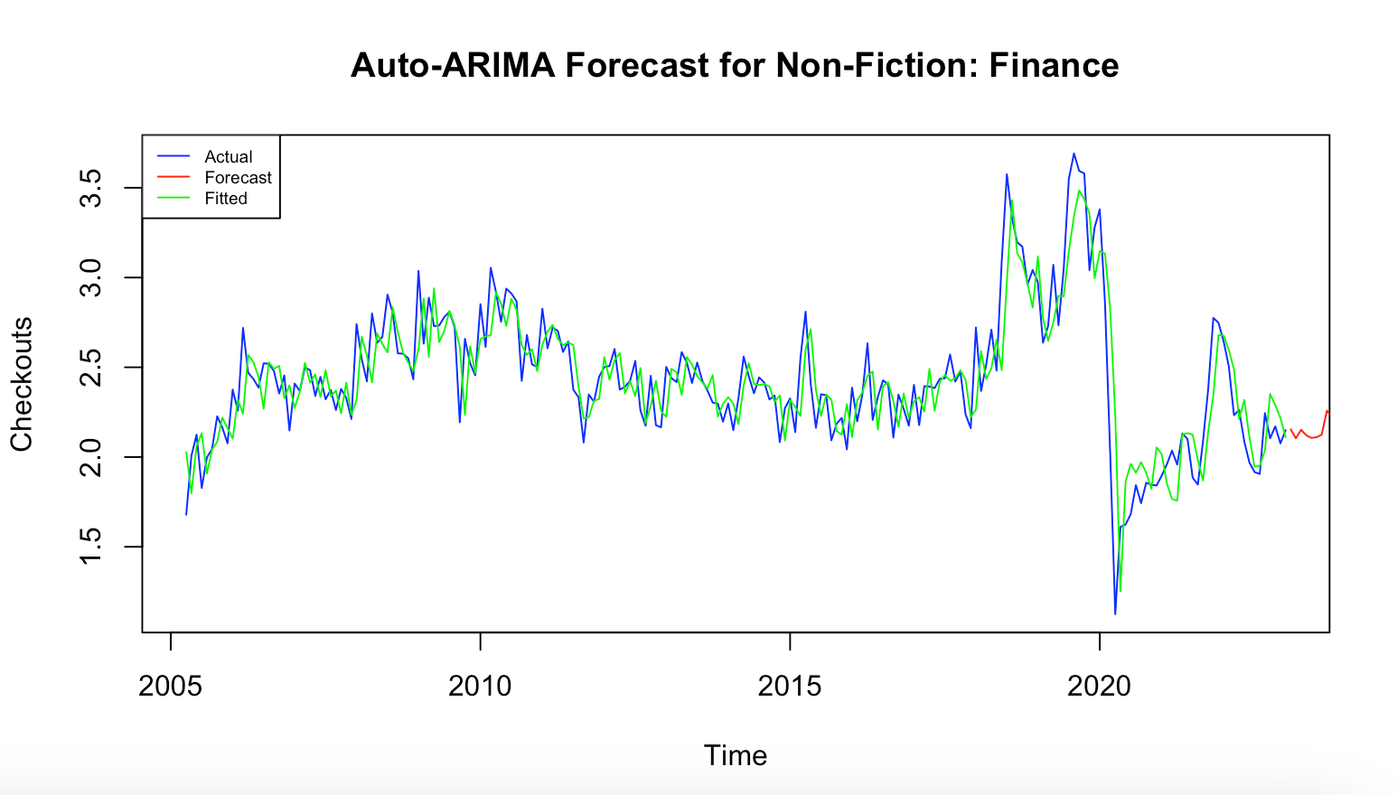
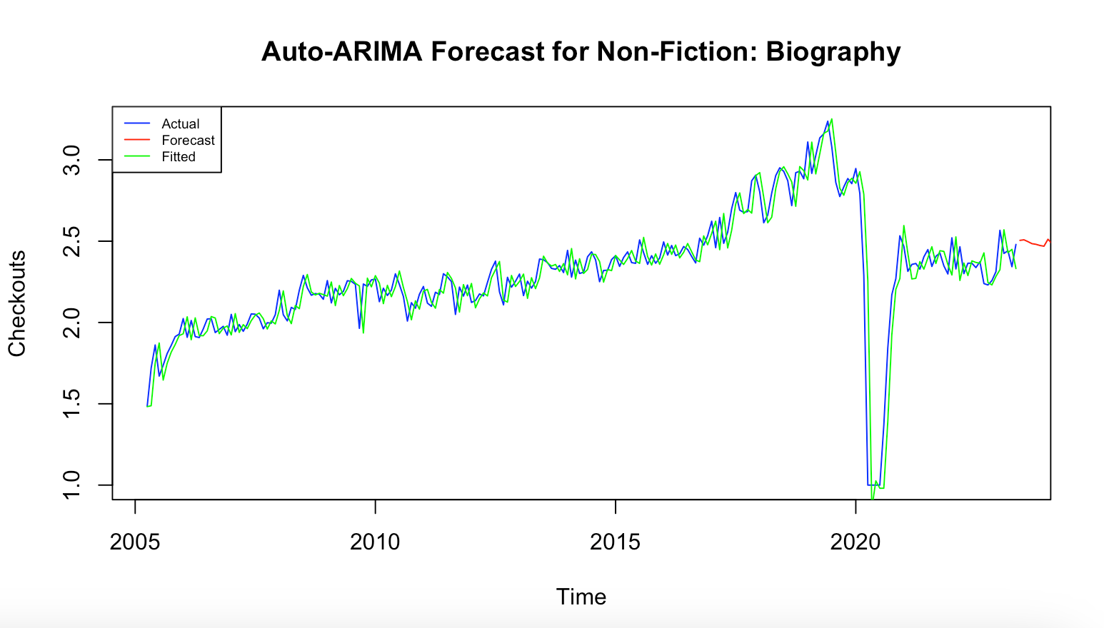
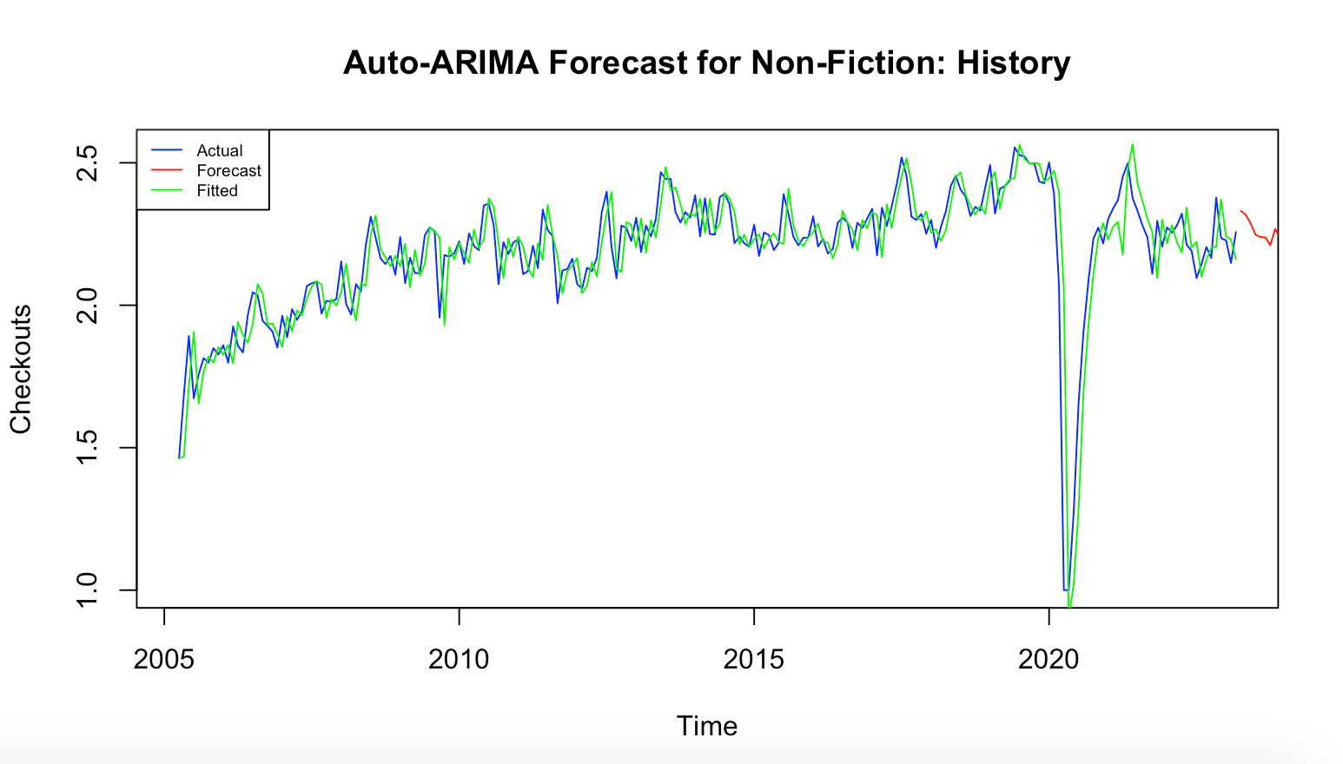
Auto-ARIMA 12 Months Forecast for Single Genre Non-Fiction Books

Slide 33
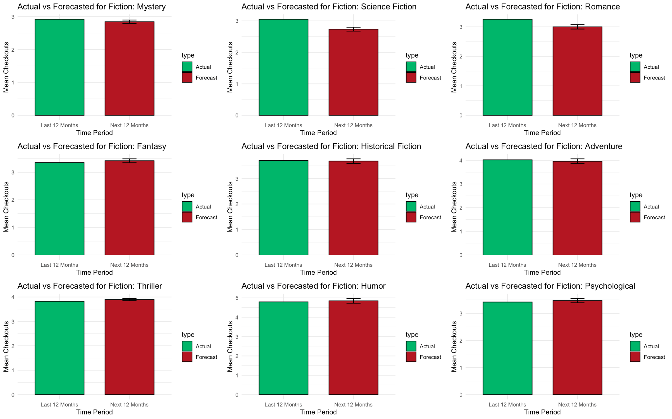
Actual Value - Forecasted Value Comparison for Fiction Genre with auto.arima()

Slide 34
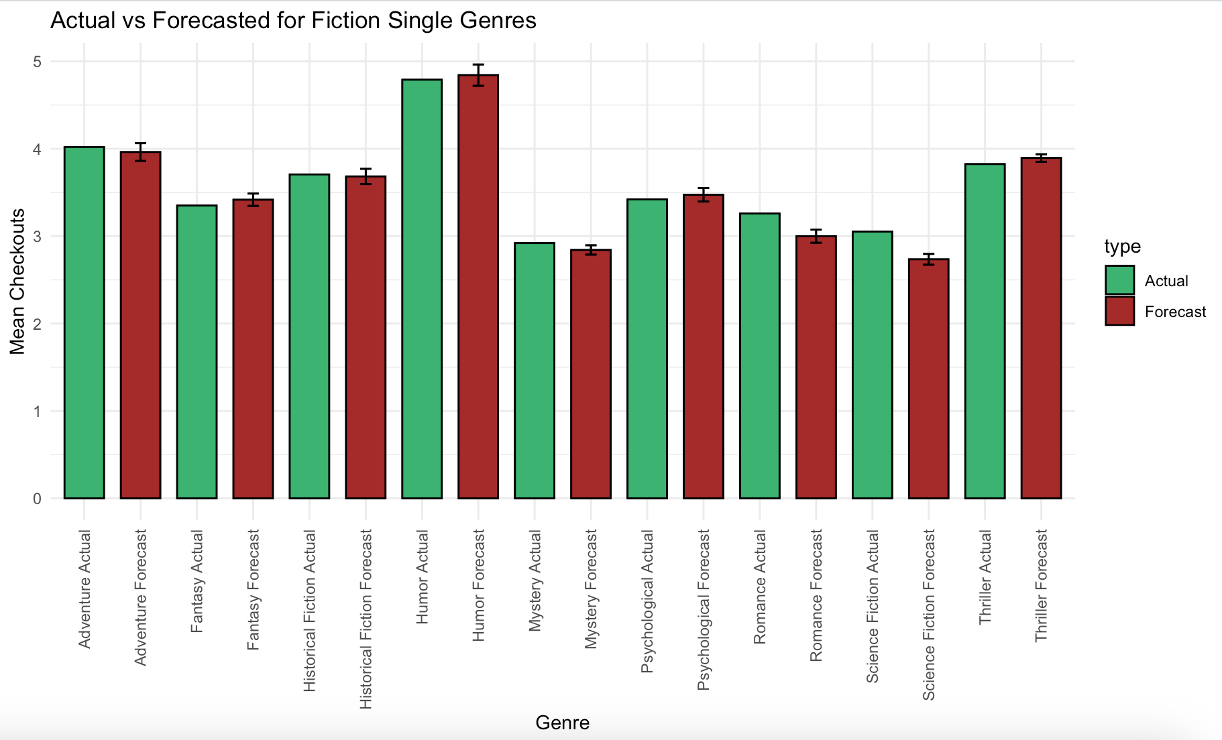
Actual Value - Forecasted Value Comparison for Fiction Genre with auto.arima()

Slide 35
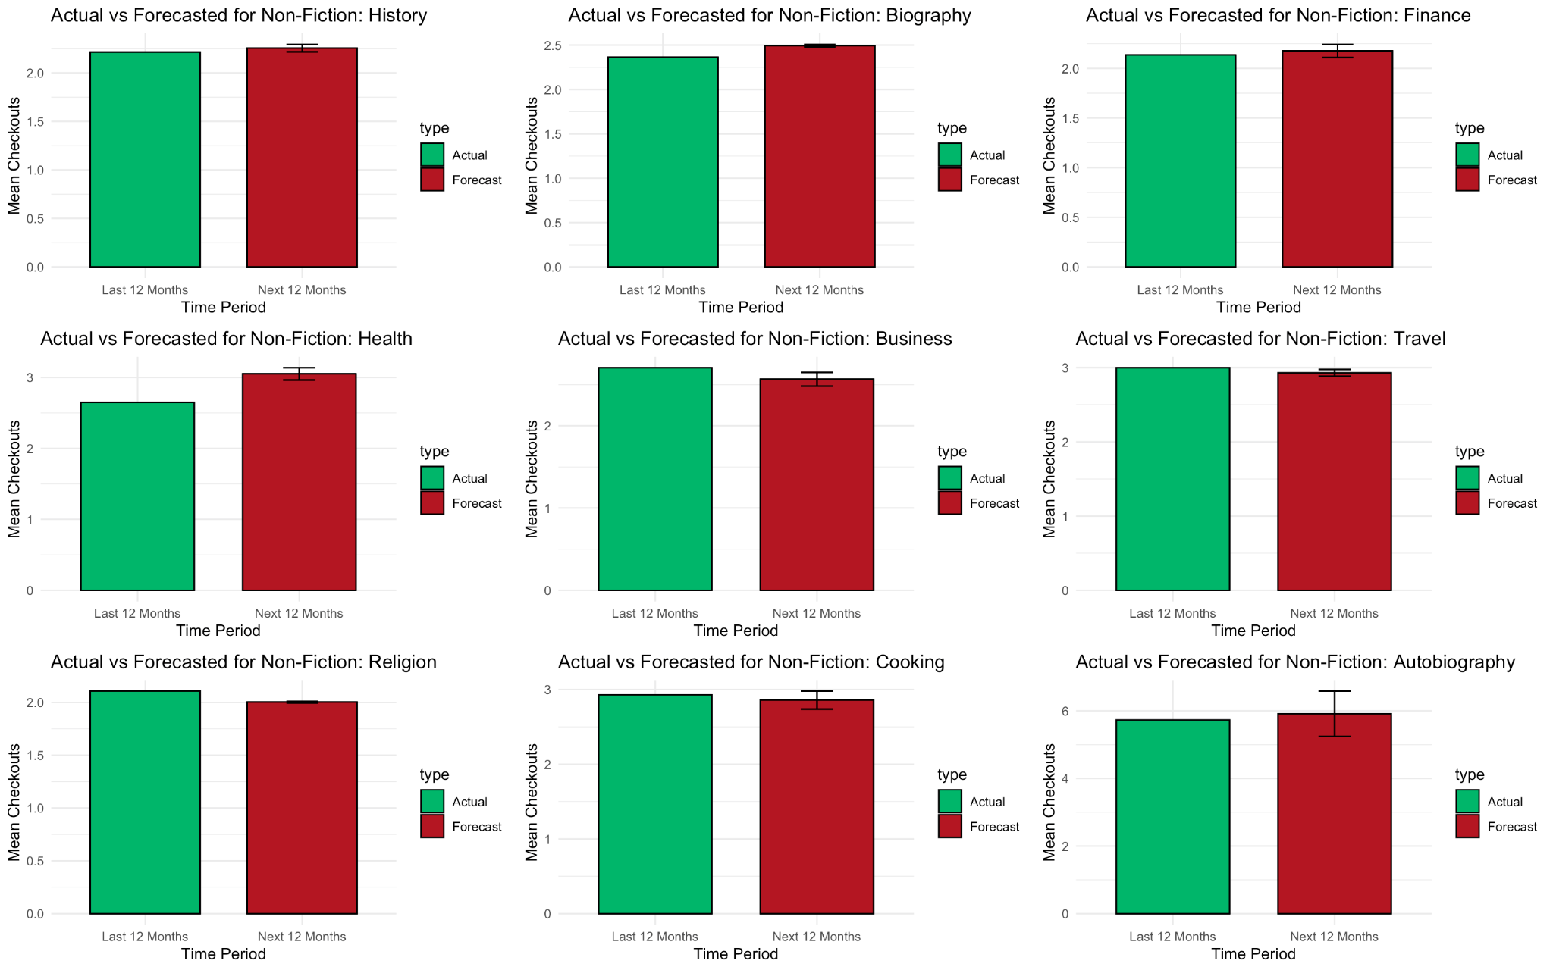
Actual Value - Forecasted Value Comparison for Non-Fiction Genre with auto.arima()

Slide 36

Actual Value - Forecasted Value Comparison for Non-Fiction Genre with auto.arima()

Slide 37

Maximum Checkouts

Slide 38


Slide 39


Slide 40


Slide 41


Slide 42


Slide 43

Total checkouts by Medium

Slide 44

Books
2 approaches:
Find the best ARIMA order
Fit SARMAX model with GBM xreg
Best model chosen by minimum RMSE on test set

Slide 45

Best ARIMA MODEL
Box-Ljung test
data: residuals(fit_o)
X-squared = 32.505,
df = 24,
p-value = 0.115
AIC=4466.82

Slide 46


Slide 47

RMSE on Test set =140594.2

Slide 48


SARMAX WITH GBM model

Slide 49

xreg= fitted GBM
Regression with ARIMA(1,1,1)(2,3,2)[12] errors
xreg=-0.4128±0.1153
AIC=4432.71
RMSE=32037.56

Slide 50


Slide 51

RMSE=47122.9

Slide 52

EBOOKS
3 approaches:
TSLM
TSLM + ARIMA refinement
Best ARIMA model with drift

Slide 53


RMSE on test set=14200.79

Slide 54

Best Arima model on residuals: ARIMA(1,1,1)(2,1,2)[12]
AIC=2962.35
RMSE on test set=13636.39

Slide 55

ARIMA(1,0,1)(1,1,2)[12] with drift
AIC=2978.52
RMSE on test set= 3370.167

Slide 56


Slide 57

AUDIOBOOKS
2 approaches:
Arima model with box-cox transformation (lambda=”auto”)
ets model

Slide 58

ETS(M,A,M) model
Smoothing parameters:
alpha = 0.6872
beta = 0.0513
gamma = 1e-04
AIC=4168.057
RMSE on test set= 53741.86

Slide 59

ARIMA(2,1,1)(2,0,0)[2] with drift
Box Cox transformation: lambda= 0.2368276
AIC=518.46
RMSE on test set= 31821.75

Slide 60

with box-cox transformation
lambda=”auto”

Slide 61


Slide 62


Slide 63


Slide 64

ERROR BARS REPRESENT THE UPPER AND LOWER BOUND OF THE FORECASTS

Slide 65
Analysis of individual books

Slide 66


Slide 67


Slide 68

BASS MODEL

Slide 69

m vs p- Bass model
m vs q - Bass model

Slide 70

GENERALIZED BASS MODEL
1 rectangular shock

Slide 71


Slide 72


Slide 73

GGM

Slide 74


Slide 75
THANK YOU FOR YOUR ATTENTION

